Slide 1
Should the fiscal rules make room for green investment?
Presentation at BdF – CEPR Workshop, 29 June 2023. Revised version, August 2023
Jean Pisani-Ferry (Bruegel, PIIE and Sciences Po)

Slide 2
“As far as the capital markets are concerned, debt is debt. Capital markets are not interested in the motives for taking on debt, however worthy they may be”
Christian Lindner et al., 14 June 2023

Slide 3
But climate investments have a return
Source: The CCC (2021)

Slide 4
The issue
In the coming decade, green transition necessitates significant investment
Convergent estimates for total investment: #2 per cent of GDP by 2030
2% of GDP for the EU
€60-70bn for France
£50bn for the UK
Consensus on aggregate numbers, much less on shares of private and public sectors
EU: 1/3 of investment effort to be borne by public sector
France: about half of the total to be borne by public sector
Why?
Different shares of public sector in total economy
Different shares of home ownership
Different economic structures
Different legacy emissions
Uneven assumptions as regards the substitutability between public and private investment

Slide 5
France: Total and public mitigation investment (annual)
 |  | Of which: public investment
Billions of euros | Supplementary investment in 2030 | Constant public share | Optimal scenario
Public buildings | 10 | 10 | 10
Private buildings (offices, wholesale and retail trade) | 17 | 0 | 2
Housing (heating and insulation) | 21 | 10 | 14
Total | 48 | 20 | 26
Infrastructure | 7 | 4 | 4
Vehicles (households) | -8 | -2 | -2
Vehicles (business) | 4 | 0 | 1
Other business investment | 13 | 3 | 4
Total | 18 | 5 | 7
Total (excluding agriculture) | 66 | 25 | 33
Source: Pisani-Ferry and Mahfouz (2023)

Slide 6
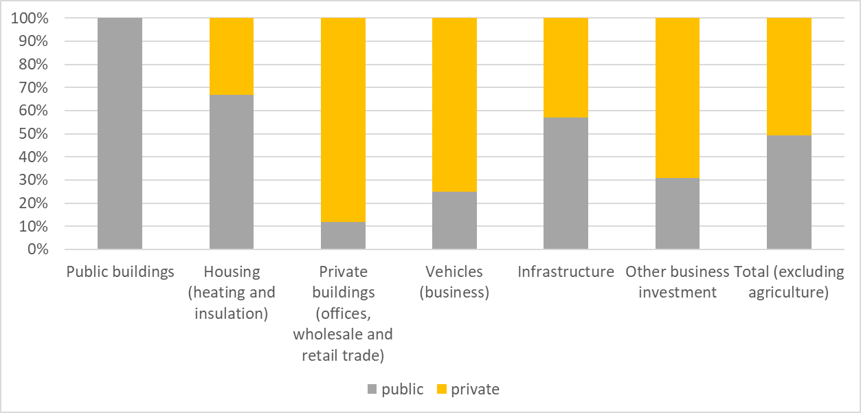
France: Distribution of future costs between private and public sectors

Slide 7
The state of the debate
Garicano (2022) proposes new European Climate Investment Facility to provide €57bn (0.4% of EA GDP) in grants and loans to EA member states, conditional on positive assessment by European Fiscal Agency
Wolff and Darvas (2022) propose “green golden rule” whereby green investments would be excluded from fiscal deficits
Yet the Commission legislative proposals of April 2023 do not specifically make room for climate investment. They only list the Green Deal as one of the common priorities that should be addressed in the national fiscal-structural plans for the adjustment period to be extended from 4 to 7 years (Annex VI of legislative proposals)
These proposals are being disputed by Lindner et al. (2023): “we are not convinced that timeframes for necessary consolidation efforts extending far beyond the cycle of a legislative period will yield the best possible results”
Result: stalemate

Slide 8
A dubious way out: financial engineering
70% of EU households own their home
Up to 95% in Romania and 87% in Poland
Only 49% in Germany and 65% in France
52% live in a house
Financial engineering can help, but only to a limited extent
ROI on housing decarbonisation investment is low
Small-scale investment (typically 30-50K€) is of limited interest for financial intermediaries
High intermediation costs
Financial risk too high, unless credit is guaranteed by the state

Slide 9
But it can help separate out good green debt from bad one
Blanket green exemption (green golden rule) would not help
Perverse incentive to pretend every debt has some green component
Characteristics of “good green debt”
Proven effect on emissions reduction
Secure economic return (revenue stream from future savings on operating costs)
Long payback time (hard to finance out of current revenues)
Reasonably homogeneous features (so that can be pooled)
Low borrower-specific credit risk
Examples
Renovation of public buildings
Replacement of public sector vehicles
Some public infrastructure investments (e.g. railroads)

Slide 10
Implementation of the green carve-out
Macro conditions
Public debt sustainability
Ceiling to green debt a function of the overall fiscal conditions
Example: lower ceiling for EDP countries (would add incentives to exiting from EDP)
Micro conditions
Long-term loans by financial agency (or agencies)
Future revenue stream (= savings on fossil fuels consumption) sequestrated for debt service
Pooling of loans to local governments
Issuance of green “impact bonds”
Surveillance by European Commission

Slide 11
Some questions
Is the return on green investment high enough to justify debt financing?
Not every investment should be eligible
How significant the eligible investment?
France: up to 1/3 of a percentage point of GDP per year
How would markets react?
Provided future revenues from Opex savings would be allocated to the servicing of green debt, its issuance would not affect financial sustainability
Market appetite for green impact bonds
What legal requirements?
No treaty change
Adaptation of legislative proposals

