Slide 1


Department of Finance
Corporate Climate Lobbying
  Zacharias Sautner, University of Zurich & SFI
  (with M. Leippold, T. Yu)
  6 March 2024
  Webinar on Climate Policy and Finance
  CEPR RPN on European Financial Architecture
Image source: Sean Pollock by Unsplash

Slide 2

Corporate climate lobbying matters
  Most countries’ efforts to combat climate change are insufficient
  Common concern: Climate action, at least in parts, is obstructed by firms’ lobbying activities
    Influence policymakers to undermine, delay, or avoid pro-climate regulations or policies
    “Scope 4 emissions”
  Corporate lobbying
    Occurs behind the scenes
    Sometimes collides with public statements on how firms plan to fight climate change
    Is not a sideshow: has real effects on climate action (Meng and Rode, 2019; Brulle, 2018; Gao and Huang, 2024)
Image source: Alexander Grey by Unsplash

Slide 3

Video of how an ExxonMobil lobbyist said that the firm fought climate science through “shadow groups” and targeted senators to weaken President Biden’s climate proposals
Tabuchi, H. (2021). In video, Exxon lobbyist describes efforts to undercut climate action.
New York Times

Slide 4
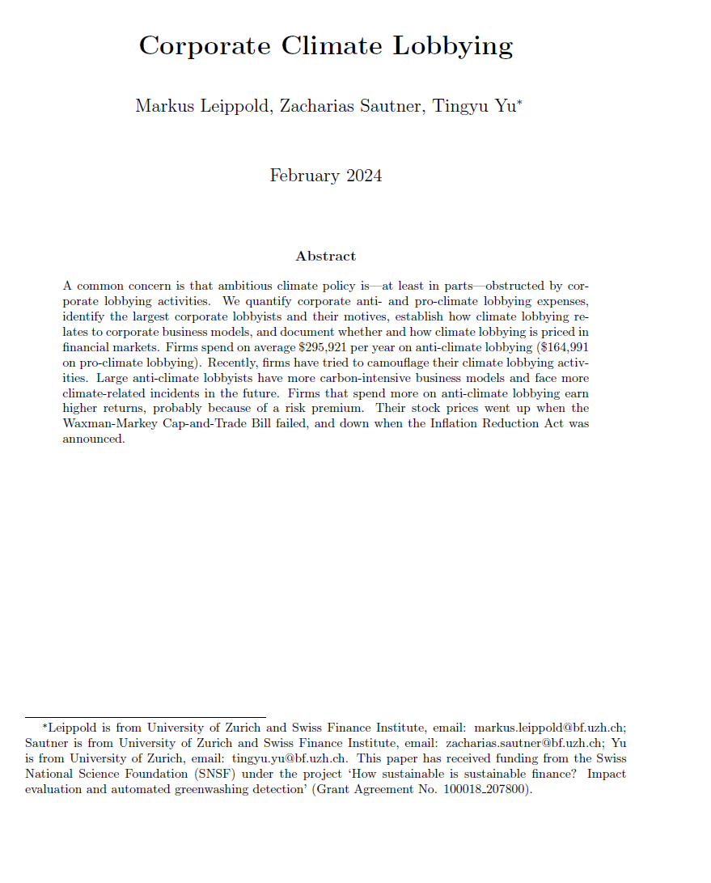

Study climate lobbying of publicly listed U.S. firms from 2001 to 2022
Three contributions
Quantify corporate anti- and pro-climate lobbying expenses, identify the largest corporate lobbyists and their motives
Establish how climate lobbying relates to corporate business models
Document whether and how climate lobbying is priced in financial markets
Paper available here: https://papers.ssrn.com/sol3/papers.cfm?abstract_id=4711812

Slide 5
Two steps to measure corporate climate lobbying
Step 1:
Climate lobbying
  Identify those lobbying reports that address climate-related topics and measure the associated lobbying amounts
    Climate-related lobbying identified based on a classification of the lobbying “issues” in a report
    An issue is “climate-related” if its description contains a climate-related keyword or bill
  Quantify the amounts of climate lobbying by allocating total lobbying expenses listed in a report across issues in the report
Step 2:
Anti- and pro-climate lobbying
  Follow Kwon et al. (2023) and calculate whether the firm’s executives or lobbyists contribute primarily to the Republican or Democratic Party
    Lobbying is anti-climate (pro-climate) if executives or lobbyists donate primarily to Republicans (Democrats)

Slide 6
Some numbers on corporate climate lobbying
On average, spending on
anti-climate lobbying amounts to
$295,921 per year
and pro-climate lobbying to
$164,991
(at the intensive margin, for firms that climate lobby)

Slide 7
Spending on corporate climate lobbying varies a lot over time
Biden Administration: Proposed more stringent climate regulation and efforts supporting climate action
Surge in climate legislation, such as the American Clean Energy and Security Act
Trump Administration: Categorical political views
Note: Figure displays the aggregate amounts of anti- and pro-climate lobbying for each quarter

Slide 8
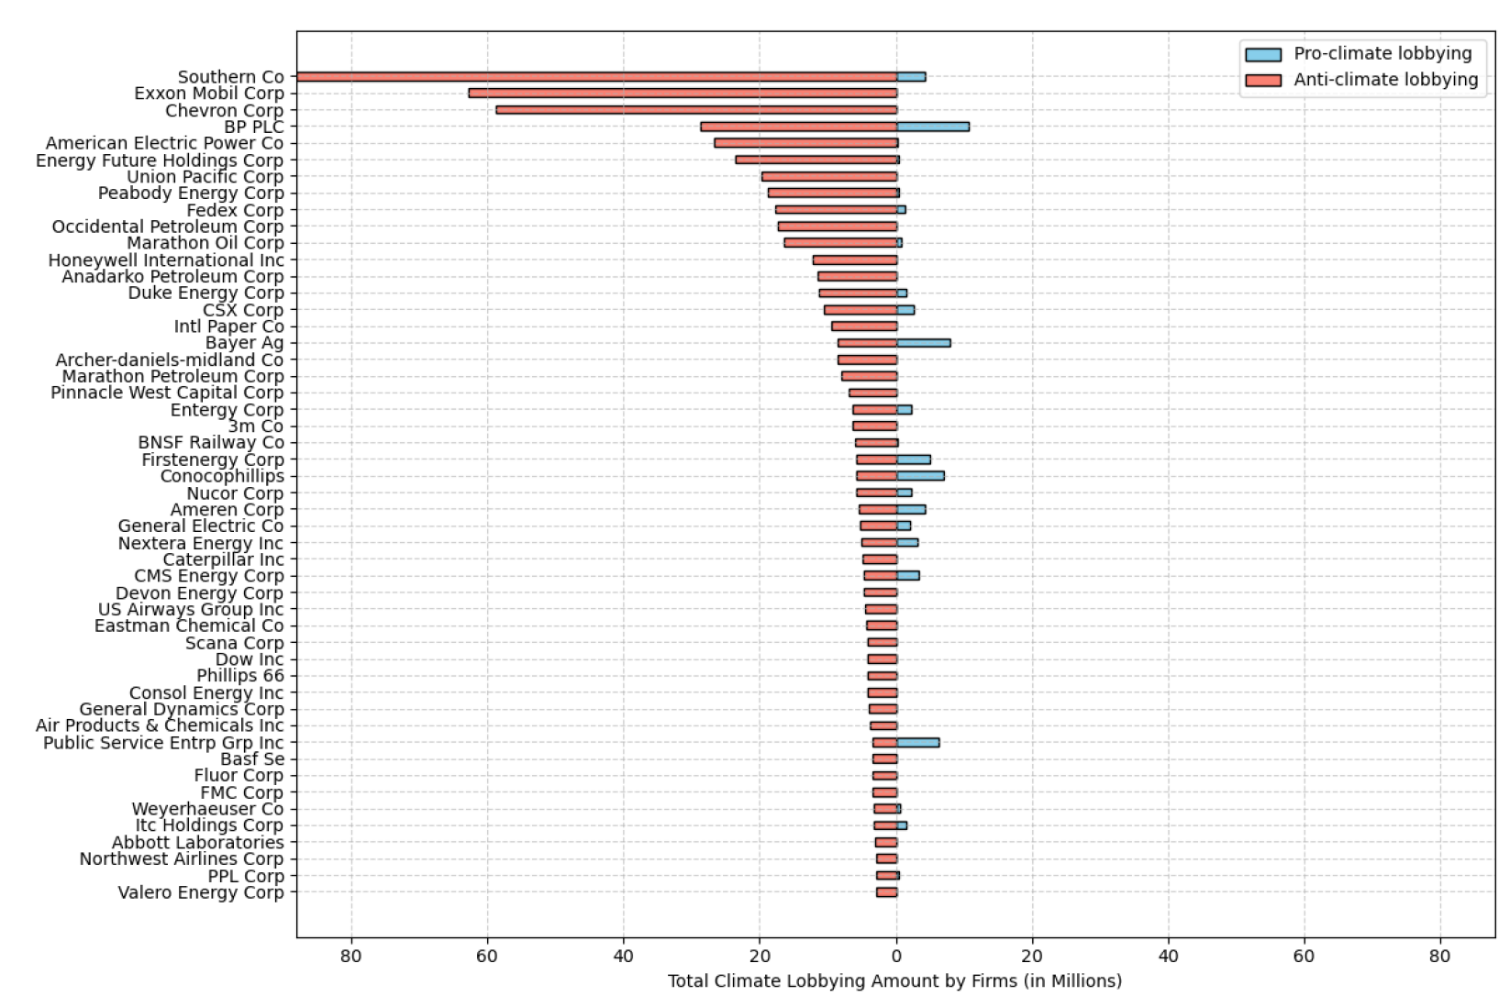





Top-50 anti-climate lobbying firms

Slide 9

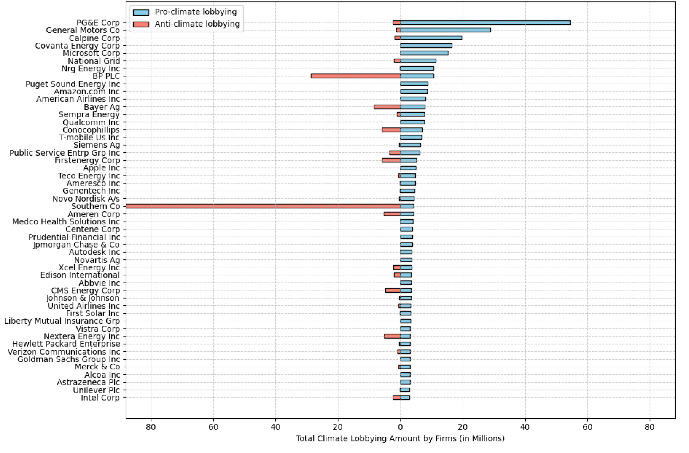




Top-50 pro-climate lobbying firms

Slide 10

Some firms try to camouflage climate lobbying
  Trend to camouflage climate lobbying, particularly among firms engaging heavily in climate lobbying
  Instead of explicitly mentioning the climate issues of concern
      -> refer in the description of their lobby activities to abstract bill codes
  These codes are not immediately identifiable as climate-related (highlights the importance of identifying lobbying not solely based on text descriptions, as we do)
    For example, bill code “H.R.5376” refers to the Inflation Reduction Act of 2022
Image source: Rick Rothenberg by Unsplash

Slide 11
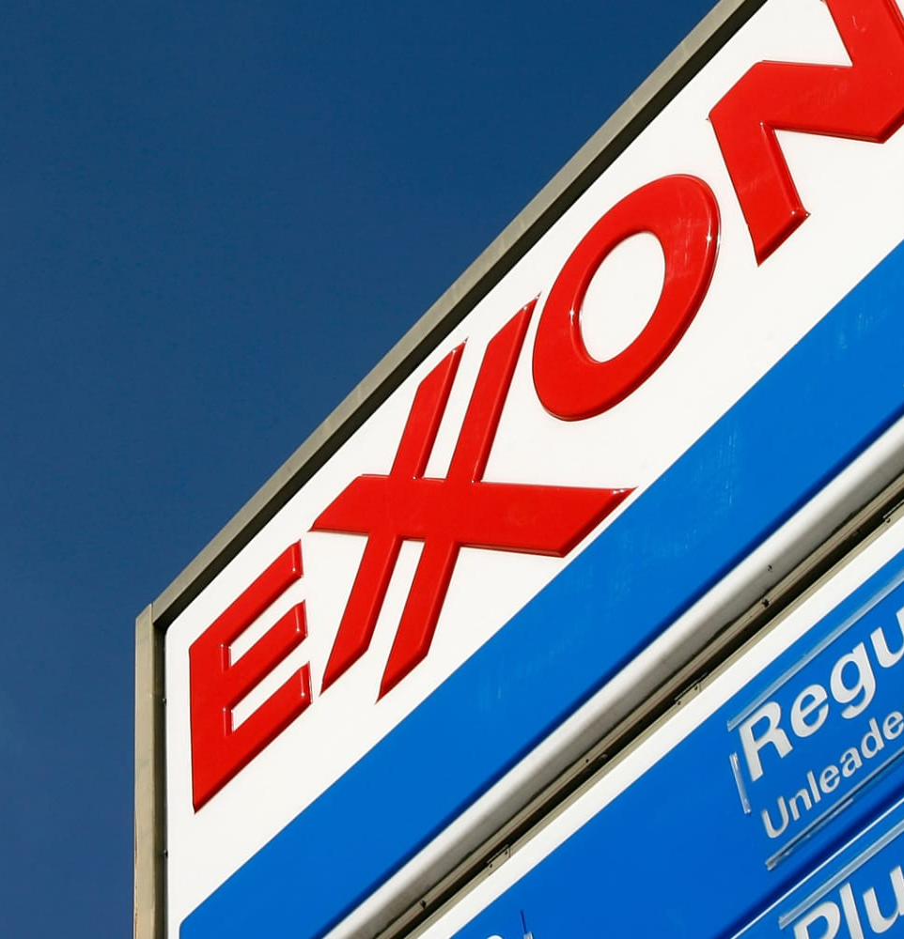
Some firms try to camouflage climate lobbying
In 2009, ExxonMobil allocated $13m to anti-climate lobbying
-> 63% can be detected explicitly in lobbying reports using keywords
  By 2022, this percentage dropped to just 18%; all remaining anti-climate lobbying expenses can only be detected using bill codes (anti-climate spending fell to $3m)
  Perhaps in response to this trend, investors increasingly worry about a lack of transparency in corporate climate lobbying

Slide 12
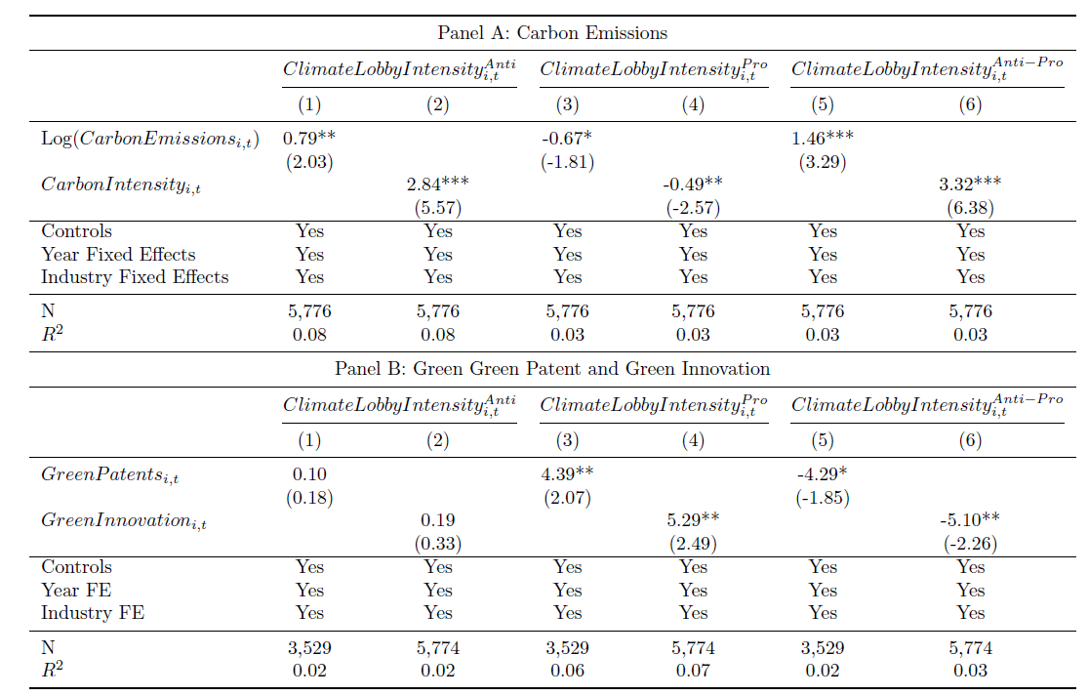
Carbon emissions and green innovation explain climate lobbying

Slide 13
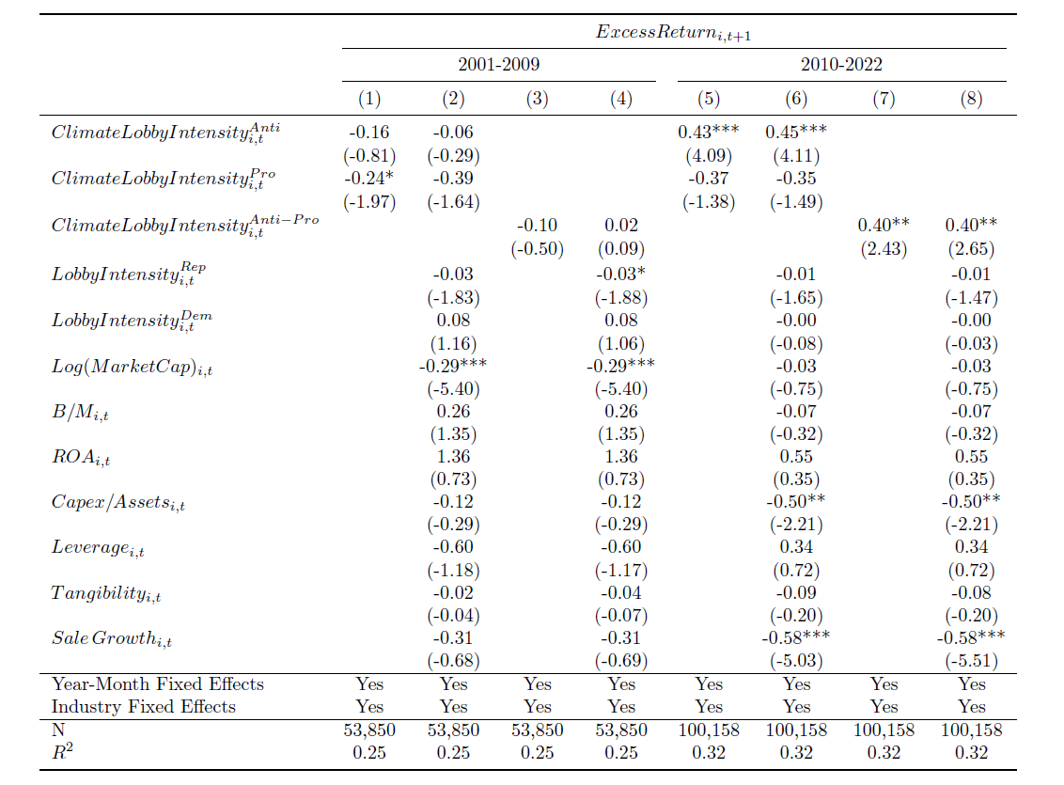
Investors demand a risk premium for anti-climate lobbying, since 2010
  Regressions follow Bolton and Kacperczyk (2021, 2023)
  1 STD increase in ClimateLobbyIntensity^{Anti} (in Col 5)
  0.36% (=0.43×84/100) higher monthly returns (or 4.33% annually)
  Holds after controlling for carbon emissions
  Lobbying not associated with higher earnings surprises

Slide 14

Why? This is what ESG Rating Agency Sustainalytics thinks
Anti-climate lobbying can constitute an investment risk by
By damaging trust in firms or leading to “name and shame” actions (reputation risk)
By leading firms to not adjust business models fast enough in the hope that lobbying succeeds (transition risk)
Images source: Beth Jnr by Unsplash

Slide 15
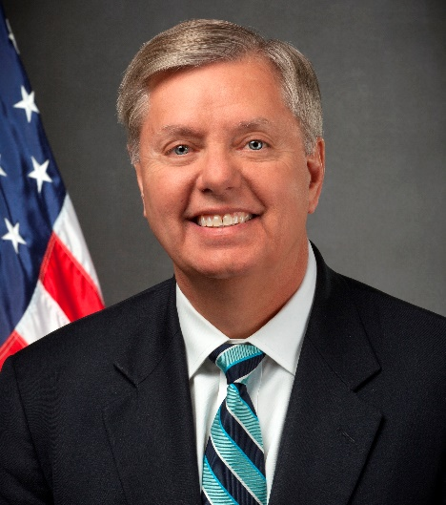
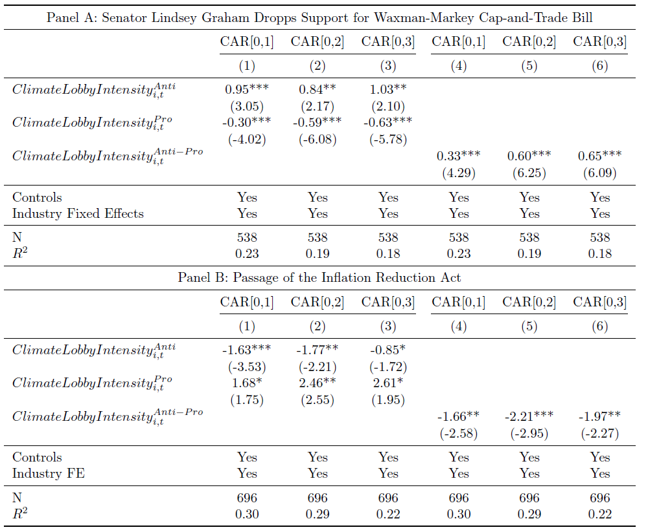
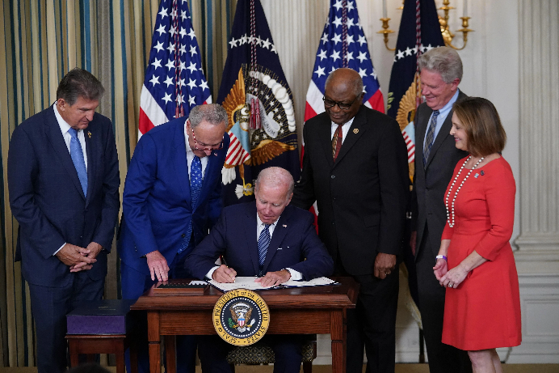
Event study evidence lines-up with risk premium channel
April 23, 2010
1 STD increase in ClimateLobbyIntensity^{Anti}
→ 0.80% higher CAR[0,1]
July 28, 2022

Slide 16
Five key takeaways
Firms spend on average $295,921 per year on anti-climate lobbying
($164,991 on pro-climate lobbying)
Recently, firms have tried to camouflage their climate lobbying activities
Large anti-climate lobbyists have more carbon-intensive business models
(and face more climate-related incidents in the future)
Firms that spend more on anti-climate lobbying earn higher returns
(risk premium)
Their stock prices went up when the Waxman-Markey Cap-and-Trade Bill failed, and down when the Inflation Reduction Act was announced

Slide 17
Climate lobbying:
  Companies should align their lobbying activities with the objectives of the Paris Agreement and address membership of trade bodies or associations that is or may appear incongruent with the company‘s climate change policy.
  Companies should be transparent about where they advocate for specific policy and legislative support.

Slide 18

Contact
Prof. Zacharias Sautner
Professor of Sustainable Finance at UZH
Senior Chair at the Swiss Finance Institute (SFI)
Co-Head Initiative in Sustainable Finance
zacharias.sautner@df.uzh.ch
www.df.uzh.ch

