Slide 1
The Social Cost of Greenhouse Gases: Recent RFF Research, Recent EPA Estimates, and the Stochastic Discounting Approach
Billy Pizer, Resources for the Future
April 3, 2023 | CEPR

Slide 2
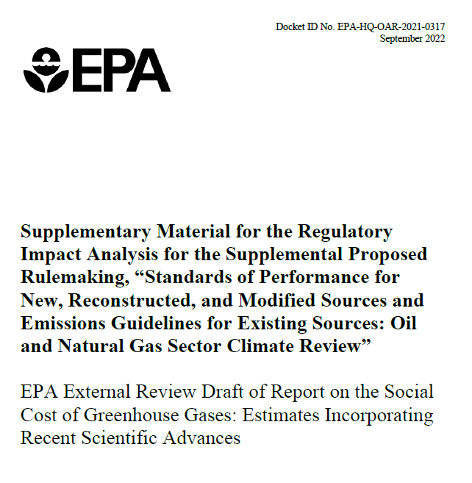

Slide 3
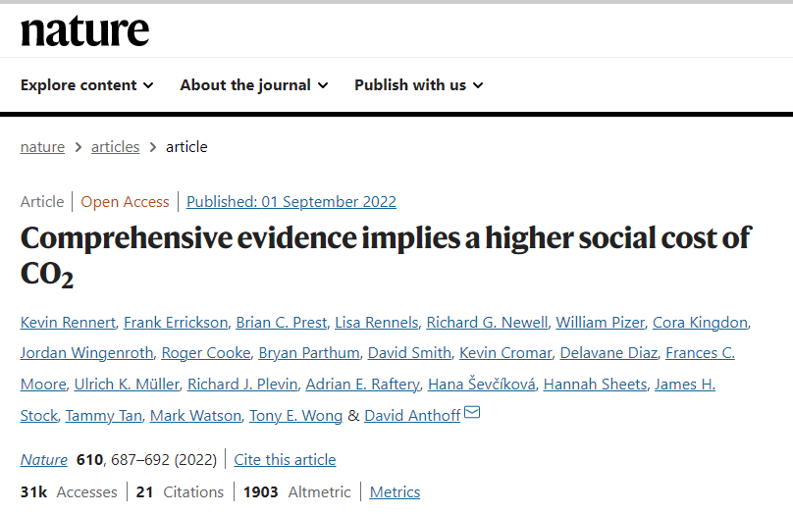
3

Slide 4
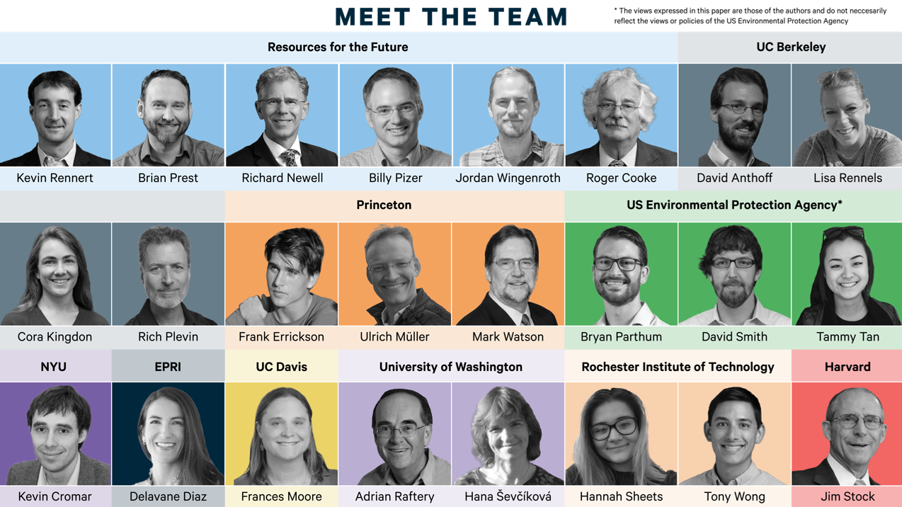
*The views expressed in this paper are those of the authors and do not necessarily reflect the views or policies of the US Environmental Protection Agency
4

Slide 5
A modular framework for calculating the SCC

Slide 6
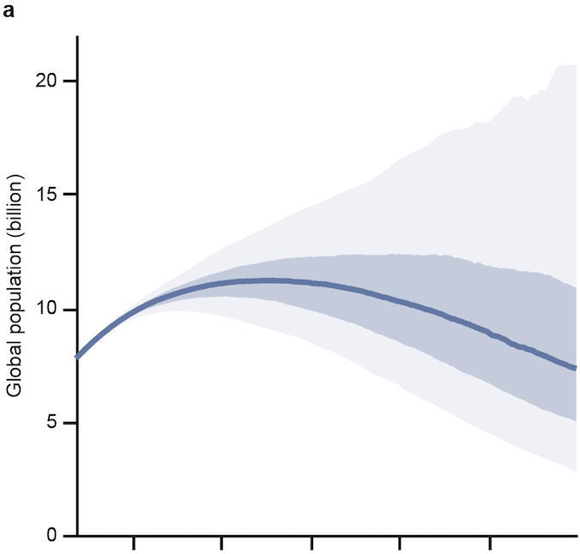
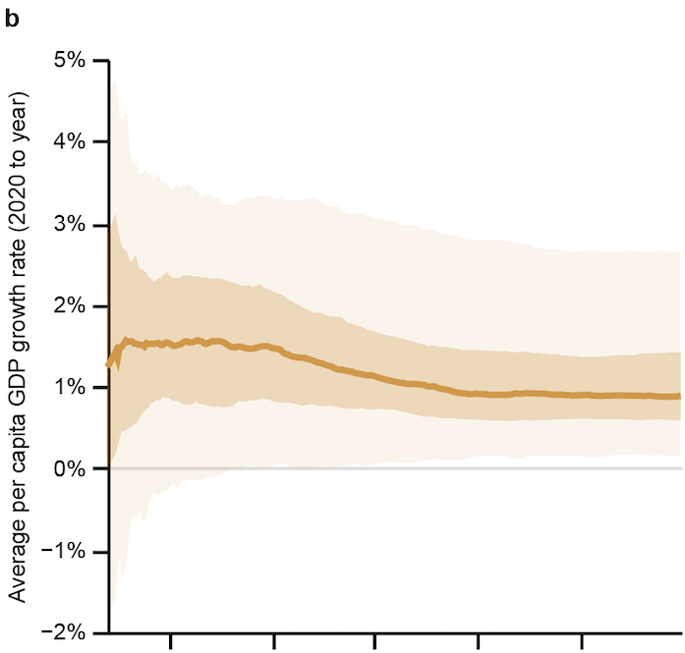
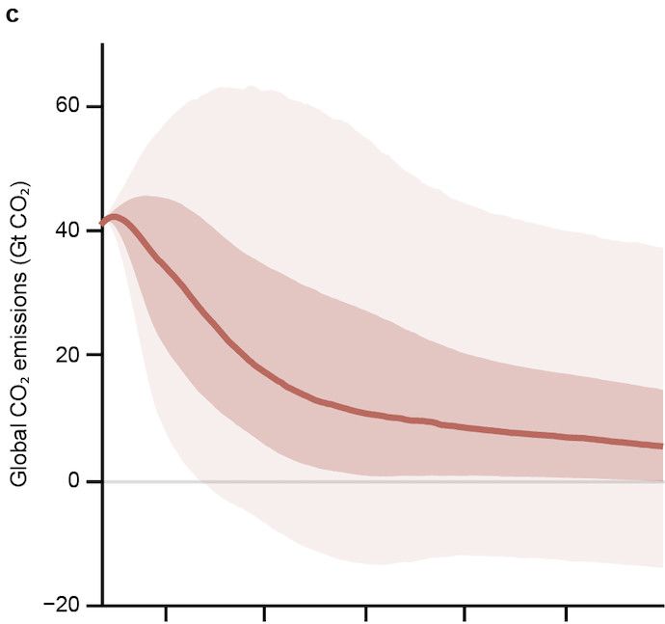
RFF Socioeconomic Projections (RFF-SPs)
Population
Growth in GDP per capita
Global CO₂ emissions
Shaded areas are 25-75% and 5-95% ranges. 10,000 draws of RFF-SP trajectories available at https://zenodo.org/record/6016583.

Slide 7
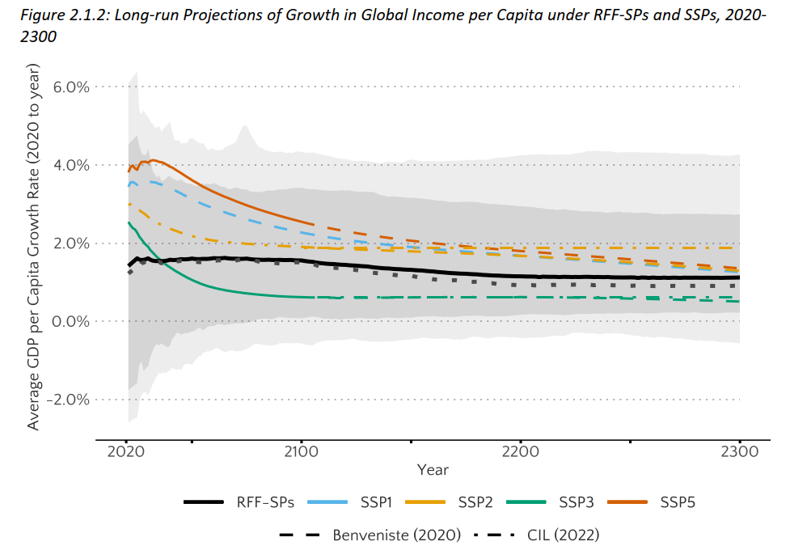
RFF-SPs: Economic Growth (country level)
Methods: Country-level econometric growth projections to 2300*, constrained using expert uncertainty from RFF Economic Growth Survey**
Results:
Median projection from experts shows much lower long-run growth than statistical model
Both sources view extremely high (>4%) and low (~0%) long-run growth as highly unlikely, but possible
* Müller, Stock, Watson (2022 REStat)
** Rennert et al. (2021 BPEA)
Solid black is RFF-SP mean, dashed black is RFF-SP median.
Shaded areas represent 5-95% and 1-99% ranges.

Slide 8
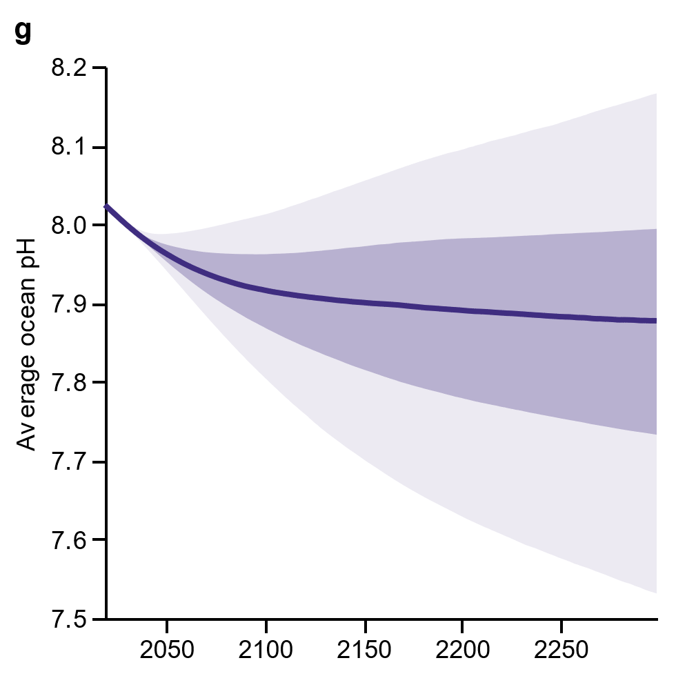
Implementation of modern climate models
CO₂ Concentrations
Global Temperatures
Response of the climate system represented by the FaIR* climate model, the BRICK & FACTS sea level rise models**, and a modeled response of ocean acidification***
Sampling emissions trajectories from the RFF-SPs as well as from the climate model parameters incorporates compounding uncertainties from both elements
Sea Level Rise
Ocean Acidification
Acidification
* Forster et al. (2021), Smith et al. (2021),
** Wong et al. (2017),
*** NASEM (2017)
8
Shaded areas represent 25-75% and 5-95% ranges

Slide 9
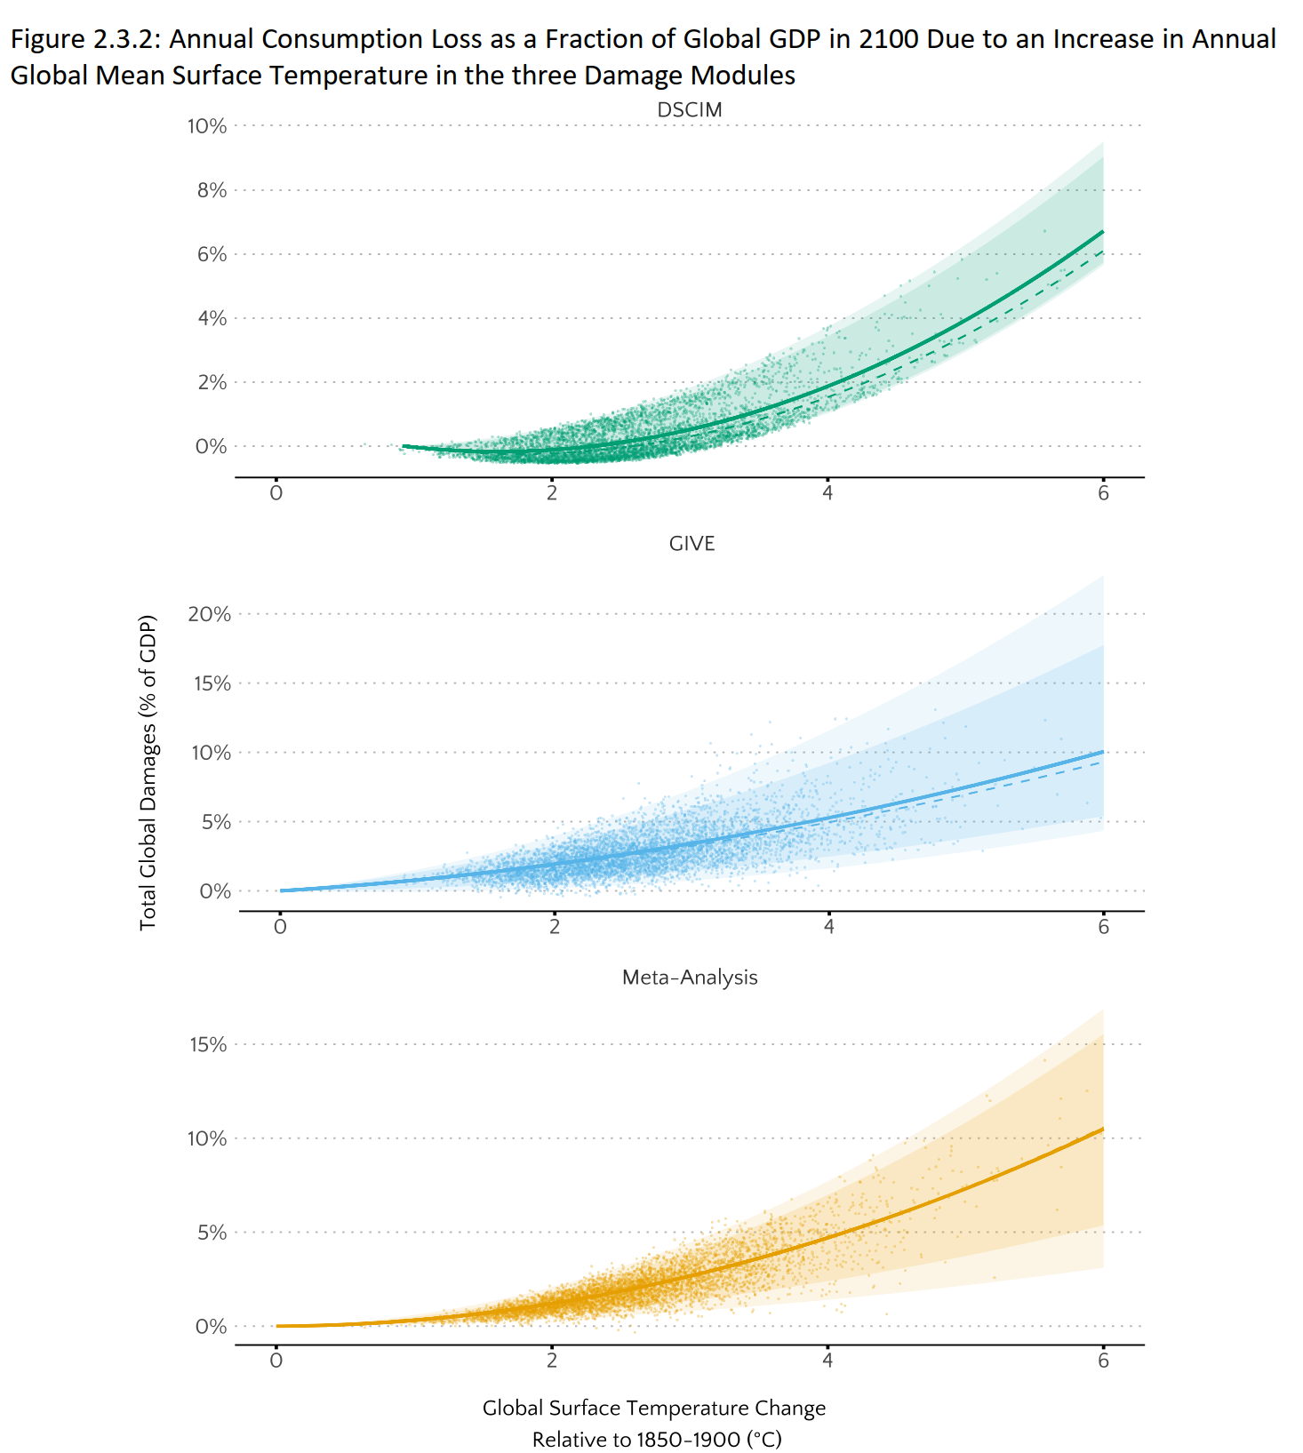
EPA Equally Weights 3 Sets of Damage Functions
Climate Impact Lab’s DSCIM Sectoral Damages
Mortality (Carleton et al. 2022)
Agriculture (Hultgren et al. 2022)
Coastal (Diaz 2016, Depsky et al. 2022)
Energy (Rode et al. 2021)
Labor productivity (Rode et al. 2022)
RFF/UC-Berkeley GIVE Sectoral Damages
Mortality (Cromar et al. 2022)
Agriculture (Moore et al. 2017)
Coastal (Diaz 2016)
Energy (Clarke et al. 2018)
Howard & Sterner (2017) Meta-Analysis
Meta-analysis of the literature to generate a top-down damage function of market and non-market damages, relating global temperature rise to a percentage loss in GDP.
9

Slide 10
Stochastic discounting tied to income growth
Asset pricing theory says that the appropriate discount rate varies with uncertain consumption growth
Accordingly, discount rate is linked to uncertain future growth rate (subscript $s$ for state and $t$ for time):
$$r_{st}=ρ+ηg_{st}$$
Captures the long-term relationship between discount rates and economic growth to account for risk
10

Slide 11
State valuation in asset pricing, and its Ramsey-like form
For an uncertain state $s$ (trajectory), the SCC is given by
$SCC_{s}⋅u^{′}\left(c_{0}\right)=$ $\sum_{t=1}^{T}{MD_{st}e^{−ρt}u^{′}\left(c_{st}\right)}$
with iso-elastic utility, $u^{′}\left(c\right)=c^{−η}$, this is equivalent to…
$$SCC_{s}=\sum_{t=1}^{T}{MD_{st }e^{−ρt}{(c_{st}/c_{0})}^{−η}}$$
$$=\sum_{t=1}^{T}{MD_{st }e^{−(ρ+ηg_{st})t}}$$
$$=e^{g_{st}t}$$
Discount Factor
11

Slide 12
Calibrated values for $ρ$ and $η$
$ρ$ and $η$ parameters calibrated via method from Newell, Pizer, and Prest (2022 JAERE) to:
Align with the consumption rate of interest in the near-term
Focus on a 2% discount rate, reflecting consensus from recent economic literature*
Reflect evidence on long-run interest rate behavior** and economic growth uncertainty***
Near-term discount rate | $$ρ$$ | $$η$$
1.5% | 0.01% | 1.02
2% | 0.2% | 1.24
2.5% | 0.5% | 1.42
3% | 0.8% | 1.57
for 2% near-term rate the rule is:
$$r_{st}=ρ+ηg_{st}$$
$$=0.2\%+1.24g_{st}$$
* Giglio et al. (2015); Bauer & Rudebusch (2020, 2021); CEA (2017); Drupp et al. (2018); etc.
** Bauer & Rudebusch (2021) *** Rennert et al. (2021); Müller, Stock, & Watson, (2022)

Slide 13
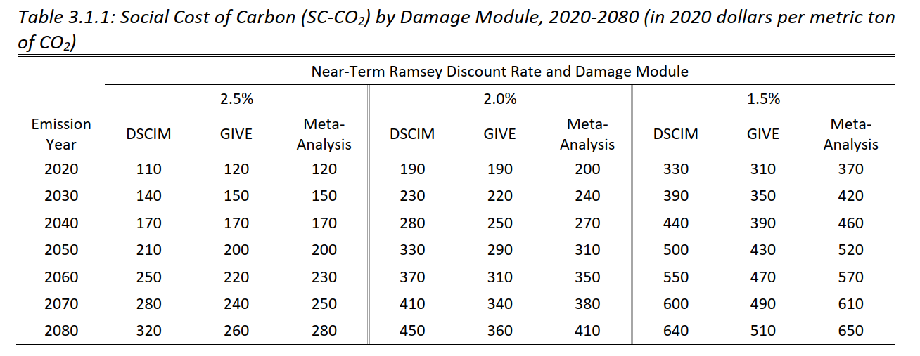
EPA Averaged Across Three Damage Functions
GIVE
Model
13

Slide 14
Thank you.
Billy Pizer(pizer@rff.org)
Social Cost of Carbon Initiative: www.rff.org/SCC

Slide 15
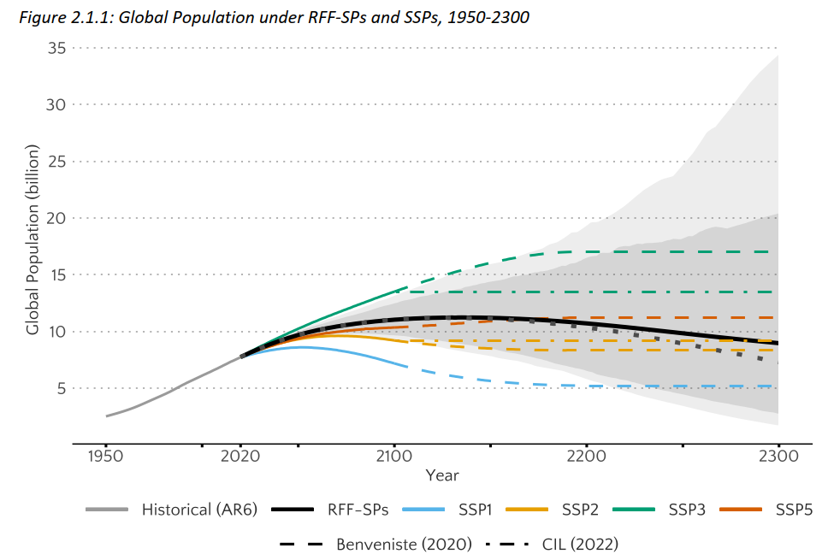
RFF-SPs: Population (country level)
Methods: Extend the fully probabilistic statistical approach used by the UN for official population forecasts, incorporating improvements from a panel of nine leading demographers*
Results: Mean/median world population peaks at ~11B mid-next century, declines to ~7.5B in 2300, but with wide uncertainty
* Raftery and Ševčíková (2021)
Solid black is RFF-SP mean, dashed black is RFF-SP median.
Shaded areas represent 5-95% and 1-99% ranges.

Slide 16
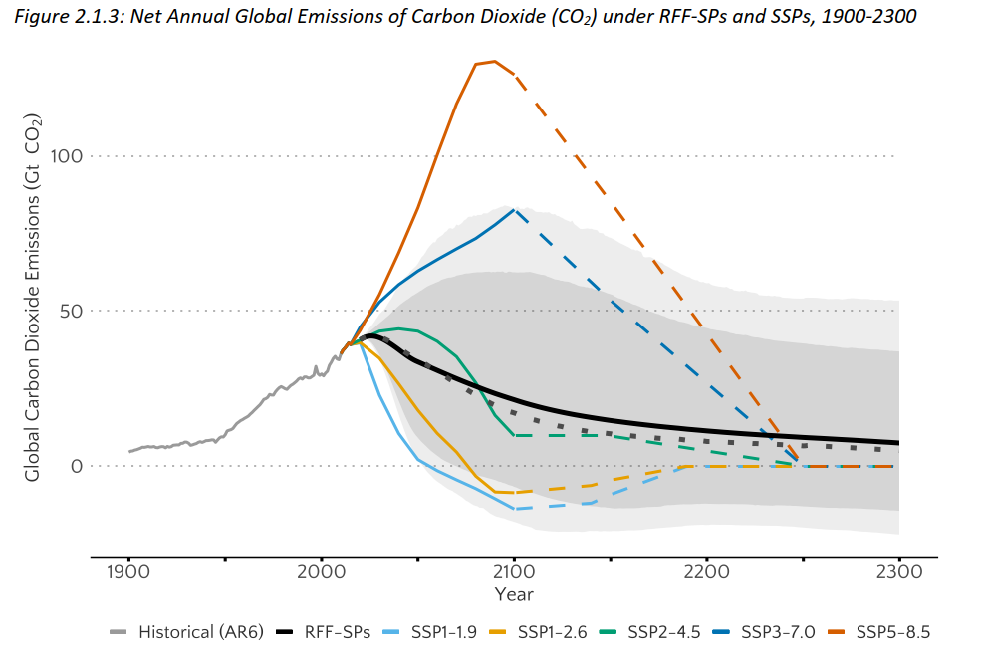
RFF-SPs: CO₂ Emissions (global)
Methods: 10 experts gave probability distributions for four categories of future emissions to 2300, including experts deeply engaged in long-term scenario development. Trajectories reflect an “Evolving Policies” case, as used by USG. CO₂ distributions conditioned on future economic growth trajectories.
Results: Median projections indicate ~60% reduction of CO₂ by 2100, with wide uncertainty, including net-zero emissions.
Solid black is RFF-SP mean, dashed black is RFF-SP median.
Shaded areas represent 5-95% and 1-99% ranges.

Slide 17
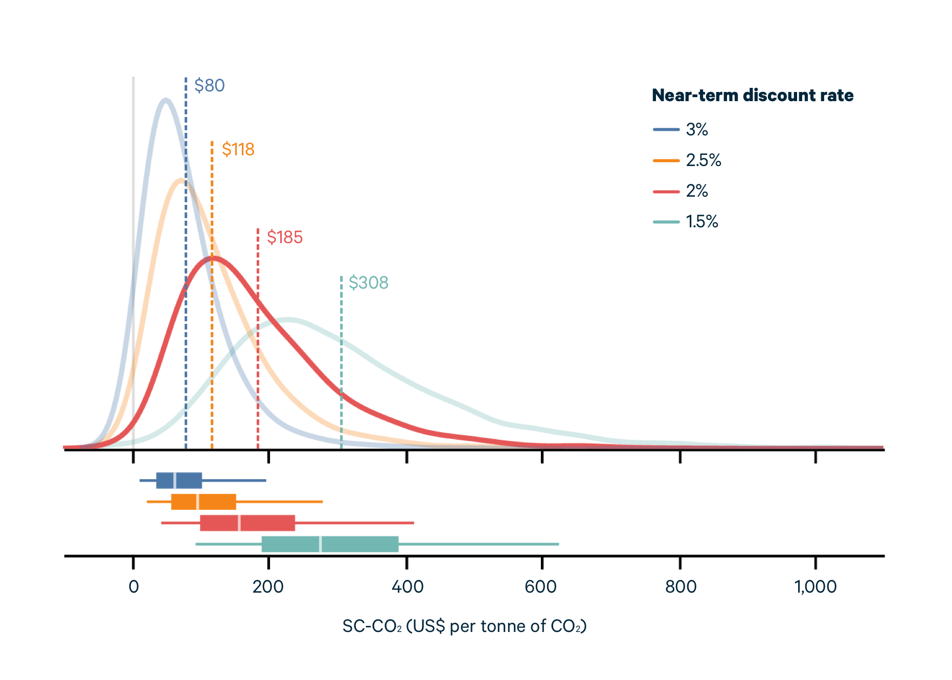
SCC estimates from RFF’s GIVE Model (Rennert 2022, Nature)
Means and distributions of the SCC from 10,000 runs of the GIVE model, for discounting approaches calibrated to 4 near-term rates
Using the preferred 2% near-term discount rate, the mean SCC is $185/ton of CO₂
Using a 3% discount rate, the mean SCC is $80/ton of CO₂, a ~60% increase over the current federal estimate of $51/ton
17

