Slide 1
Diversity, Pluralism and Tolerance:
The Roots of Economic Progress?
Joel Mokyr
Departments of Economics and History
Northwestern University
Eitan Berglas School of Economics
University of Tel Aviv
1
1
International Macro History Online Seminar Lecture, February 2024
Notes:
Global Capitalism Master Class
1
1

Slide 2
Is Diversity a “good thing”?
Diversity is widely seen as a desirable objective. Universities have “diversity officers” whose job it is to increase diversity and encourage the inclusion of under-represented minorities.
This policy has two sources of support, one is based on ethics, the other is about efficiency.
The idea that low diversity is the result of sins of the past such as colonialism and racism that have led to systemic discrimination against some groups that are now under-represented. Hence fairness and justice demand that these be addressed.
The idea that, whatever its causes, low-diversity is inefficient and/or impedes economic growth. It is argued that diversity improves economic performance and stimulates creativity and growth by drawing on a larger variety of cultural material and thus increases the options for innovation and effective management and cooperation.
2
2
International Macro History Online Seminar Lecture, February 2024
Notes:
Global Capitalism Master Class
2
2

Slide 3
Economists are primarily interested in the efficiency argument, though some voices such as McCloskey claim that we are ignoring ethics at our peril.
My main purpose here is (1) to lay out the issues a bit better, translate some of the themes into a more precise and rigorous set of concepts in the terms of the new institutional economics, (2) briefly describe some of the best work that has been done by economists, and then (3) see what we know and what we can learn from economic history.
3
3
International Macro History Online Seminar Lecture, February 2024
Notes:
Global Capitalism Master Class
3
3

Slide 4
First question: diversity of what?
4
4
International Macro History Online Seminar Lecture, February 2024
Notes:
Global Capitalism Master Class
4
4

Slide 5
An (incomplete) taxonomy of diversities
Definitions: the population consists of groups or subpopulations that share a special “trait” or characteristic that sets them apart from other groups.
We can think of diversity as having many overlapping dimensions in different traits:
Genetic diversity, related to but by no means identical to ethnic diversity.
Phenotypic diversity (not the same as genetic diversity)
Ethnic/national-origins diversity
Linguistic diversity
Religious diversity
Other cultural/ideological diversity
Cognitive and intellectual diversity
5
5
International Macro History Online Seminar Lecture, February 2024
Notes:
Global Capitalism Master Class
5
5

Slide 6
Two classes of traits
Traits:
Some of these traits are acquired at birth or hardwired: genetic, phenotypical, ethnic origin.
Others are choice or acquired variables such as cultural beliefs, preferences, and religion.
6
6
International Macro History Online Seminar Lecture, February 2024
Notes:
Global Capitalism Master Class
6
6

Slide 7
Three separate concepts: Diversity, Tolerance, Pluralism
“Diversity” is about outcomes. How are the different sub-populations with different traits represented across the economy and what are their relative socio-economic status, access to education, quality housing, healthcare, high-prestige jobs etc.
“Tolerance” is about preferences, values, and beliefs (“culture”): how do I feel about others who are not like me in one or more dimensions?
“Pluralism” is about institutions: what are the rules (i.e., laws, norms, customs, conventions) that govern how different groups are treated?
7
7
International Macro History Online Seminar Lecture, February 2024
Notes:
Global Capitalism Master Class
7
7

Slide 8
Why is diversity thought to be efficient? 1. Static gains
Diversity itself can be more efficient for a number of reasons:
It can take advantage of complementarities between groups.
It supports a greater division of both labor and knowledge between individuals and groups that differ and therefore encourages specialization.
It facilitates the gains from trade between groups that have different comparative advantage if we remove barriers and reduce inter-group transactions costs.
8
8
International Macro History Online Seminar Lecture, February 2024
Notes:
Global Capitalism Master Class
8
8

Slide 9
Why is diversity thought to be efficient? 2. Dynamic Gains
These gains are static. How about dynamic gains due to technological progress and creativity?
At first blush more diverse societies can be more creative because it is thought that they allow ideas to draw from a larger cultural gene-pool (“meme-pool”?).
However: Competition and complementarities between groups will increase static and dynamic efficiency iff the relations between the groups are harmonious and peaceful and subject to rules.
9
9
International Macro History Online Seminar Lecture, February 2024
Notes:
Global Capitalism Master Class
9
9

Slide 10
The economic benefit of diversity is not a new idea.
Thomas Aquinas argued in the 13th century that diversity among creatures was necessary in order that "the divine goodness might the more perfectly be bestowed on things" and adds "there should be diversity among them, so that what could not be perfectly represented by one single thing, might be more perfectly represented in various ways by things of various kinds.“
10
10
International Macro History Online Seminar Lecture, February 2024
Notes:
Global Capitalism Master Class
10
10

Slide 11
Recombination and Synergy
When by recombining two hitherto disjoint ideas or cultural features, we get something new and much better than the two previous elements (“synergy”).
Much of technological progress is not so much due to new ideas but the recombination or hybridization of existing ideas in new combinations (Weitzman, 1998). Hence the larger the reservoir, the better.
11
11
International Macro History Online Seminar Lecture, February 2024
Notes:
Global Capitalism Master Class
11
11

Slide 12
What, then, is pluralism?
Pluralism is about the institutions (in the Northian sense) that support peaceful co-existence and cooperation between groups that are different in some definable way; in the limiting case it is embodied in “de pluribus unum”: groups of different qualities can form a cooperative equilibrium and form a single unit for specific purposes while retaining their different traits.
In the context of the new institutional economics, it is a set of institutions that enables cooperative and peaceful diversity and is thus likely Pareto-improving: absence of a state religion, multiple official languages, color-blind institutions. Pluralism permits behaviors and beliefs that may be abhorrent to others but are allowed by pluralist institutions as long as they are victimless (create no externalities).
12
12
International Macro History Online Seminar Lecture, February 2024
Notes:
Global Capitalism Master Class
12
12

Slide 13
Tolerance
Tolerance:
The cultural foundation of pluralism. It measures preferences: how much do we care about what others believe or what they look like.
In the limit, perfect tolerance means we are utterly indifferent to the traits of others, and we don’t care what they believe as long as they do not act on it and create negative externalities.
It measures a willingness to “let a hundred flowers bloom.”
13
International Macro History Online Seminar Conference 2024
13
Notes:
Global Capitalism Master Class
13
13

Slide 14
Remark: It is highly unlikely that such an ideal tolerant society will ever be attained: we have been hardwired by evolution for homophily (e.g., Fu, Nowak, Christakis, and Fowler, 2012), and while heterophily is observed when there are strong complementarities or symbioses, homophily is far more common.
One expert (Christakis, 2023) wrote recently that “The evolution of cooperation [within the in-group] requires out-group hatred. Which is really sad.”
14
International Macro History Online Seminar Conference 2024
14
Notes:
Global Capitalism Master Class
14
14

Slide 15
This is why pluralist institutions are so important
Pluralist institutions can be seen as “civilizing agents” --- they prevent intolerant and bigoted people from acting on their aversions and instincts and overcome their “natural” proclivity to be suspicious of others who look, behave, think, or talk differently and not act on their heterophobia (“dislike” of such people). This will allow for diversity to be a more salutary force.
Moreover: pluralism may affect tolerance: The well-known existence of feedback from institutions to preferences implies that the preferences may eventually change and become more tolerant. If individuals are socialized in a society that has strong pluralist institutions, they are likely internalize those norms in their preferences and become more tolerant.
15
International Macro History Online Seminar Conference 2024
15
Notes:
Global Capitalism Master Class
15
pssssst
15

Slide 16
The mother of all pluralist institutions
16
16
International Macro History Online Seminar Lecture, February 2024
Notes:
Global Capitalism Master Class
16
16

Slide 17
Digression: Is Cultural Pluralism invariably desirable?
Religious or intellectual tolerance are the foundation of pluralist institutions that allow people to “enjoy” highly diverse and heterodox beliefs and behaviors even if others reject them (e.g., paganism, drug use, sexual behaviors, the wearing of religious attires such as hijabs, yarmoolkas, tattoos, various forms of eccentricity).
But how do we deal with fake and malicious beliefs such as holocaust denial, Satanic worship, or racist and eugenicist doctrines?
17
17
International Macro History Online Seminar Lecture, February 2024
Notes:
Global Capitalism Master Class
17
17

Slide 18
In defense of crackpots and conspiracy theories
At some level this may seem innocuous, why care if others believe in conspiracy theories or nutty interpretations of the universe?
For example, what kind of harm is caused if some people believe that the earth is only 5,782 years old and that dinosaurs coexisted with humans? Moreover, even if 99.9 % of all crackpot theories are just that, we can never be wholly sure that a tiny fraction of them may not have some unsuspected value.
The only condition is that they are victimless and don’t break the law when acting on it. That said, victimless ness and laws delineating between free speech and hate speech, for example, remain a gray area. Hence pluralist institutions are always and everywhere a “second best” outcome.
18
18
International Macro History Online Seminar Lecture, February 2024
Notes:
Global Capitalism Master Class
18
18

Slide 19
Now to the main question:
Is (and was) diversity good for the economy?
19
19
International Macro History Online Seminar Lecture, February 2024
Notes:
Global Capitalism Master Class
19
19

Slide 20
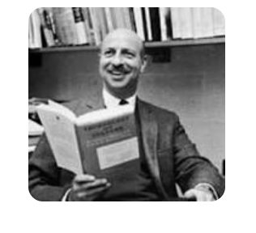
Here is a variation on what is known in the History of Technology as Kranzberg’s Law:
Adapted to the issue at hand, the variation is:
Diversity is neither good nor bad, nor is it neutral.
What does that even mean?
I interpret it to mean that, much like technology, diversity has a substantial impact, but the direction of the effect depends on other factors.
20
20
International Macro History Online Seminar Lecture, February 2024
Notes:
Global Capitalism Master Class
20
20

Slide 21
Central proposition:
The net economic effects of diversity are mediated by institutions.
In a regression setting, what would matter is the interaction term of institutions and diversity and its effect on economic performance.
In this sense diversity is similar to natural resources: are they a curse or a blessing? That depends on the institutions --- if the presence of natural resources is paired to good institutions, it leads to prosperity (Norway, Canada); if the institutions are bad, they may be a curse (Russia, Equatorial Guinea).
21
21
International Macro History Online Seminar Lecture, February 2024
Notes:
Global Capitalism Master Class
21
21

Slide 22
What is the evidence that diversity is economically beneficial?
Two different questions:
Is it beneficial on the Micro (firm) level?
Is it beneficial on the Macro (economy) level?
22
22
International Macro History Online Seminar Lecture, February 2024
Notes:
Global Capitalism Master Class
22
22

Slide 23
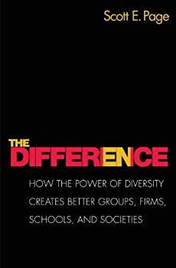
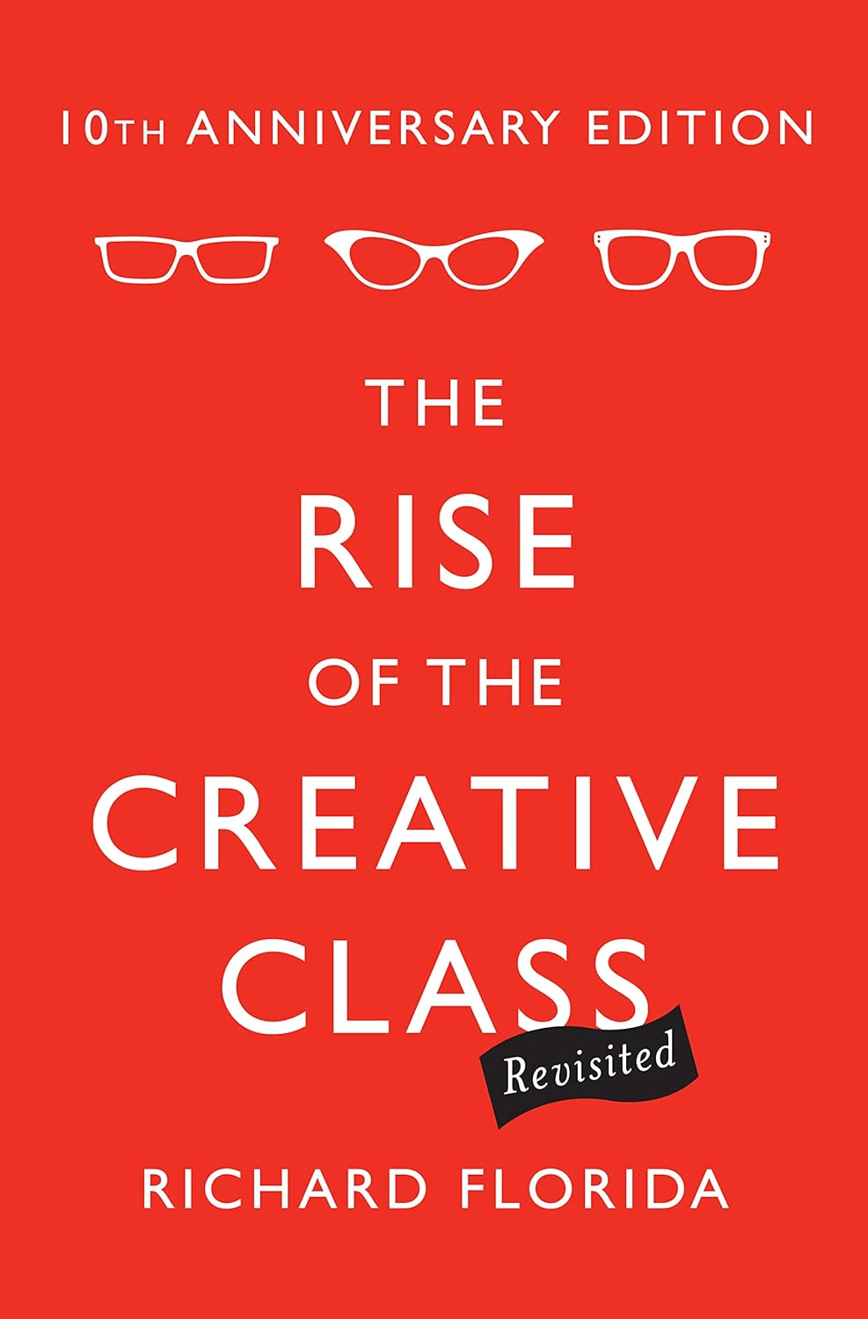
On the micro-level:
The Management literature has produced reams of papers on the effects of diversity at the level of the firm since the widely-cited survey by Millikens and Martins (1996).
The evidence for the benefits of diversity is ambiguous. Powerful defense of cognitive diversity is Scott Page’s The Difference and of
cultural diversity Richard Florida’s Rise of the Creative Class.
23
23
International Macro History Online Seminar Lecture, February 2024
Notes:
Global Capitalism Master Class
23
23

Slide 24
Empirical work is extensive in the management literature but the findings seem very mixed: One meta-analysis (Stahl et al., 2010) finds that cultural diversity at the firm level inherently involves trade-offs, meaning that the “optimal mix” of groups may vary depending on the specific task.
One finding is that culturally diverse teams had higher creativity, but also more conflict and less social integration.
The evidence on the micro-level suggests that cultural diversity does not have a direct impact on team performance but rather that the effect is indirect, mediated by “process variables” such as creativity, cohesion, and conflict; and is moderated by contextual factors such as team tenure, the complexity of the task, and whether the team is co-located or geographically dispersed.
24
24
International Macro History Online Seminar Lecture, February 2024
Notes:
Global Capitalism Master Class
24
24

Slide 25
Diversity at the Firm Level
In a more recent survey, Stahl and Maznevski (2021) distinguish between “deep-level” diversity (unobservable characteristics, including attitudes, values, and religious beliefs) and “surface-level” (e.g., looks, dress).
Deep level diversity is associated with more “creativity” due to its relationship with higher information diversity (“larger meme pool”), whereas surface-level (phenotypical) diversity, such as race, which can raise social identity threats, was negatively related to creativity and innovation for simple tasks.
On the whole, most of the effects found are not very large.
25
25
International Macro History Online Seminar Lecture, February 2024
Notes:
Global Capitalism Master Class
25
25

Slide 26
On the macro-level
On the macro-level, the matter is equally ambiguous. Do ethnically, religiously or linguistically diverse (“fractionalized”) nations perform better economically?
Here are some diagrams, inspired by the seminal paper by Alesina et al., “Fractionalization” (J. Ec. Gr., 2003; see also the survey by Alesina and LaFerrara in the J. Ec. Lit., 2005), updated to 2019.
26
26
International Macro History Online Seminar Lecture, February 2024
Notes:
Global Capitalism Master Class
26
26

Slide 27
Religious Fractionalization
27
27
International Macro History Online Seminar Lecture, February 2024
Notes:
Global Capitalism Master Class
27
27

Slide 28
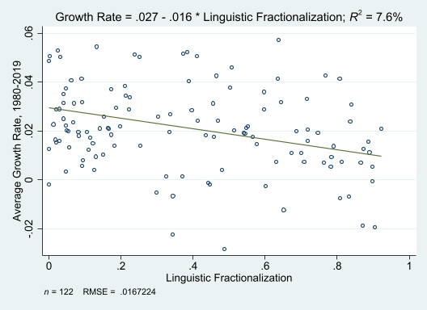
Linguistic Fractionalization
28
28
International Macro History Online Seminar Lecture, February 2024
Notes:
Global Capitalism Master Class
28
28

Slide 29
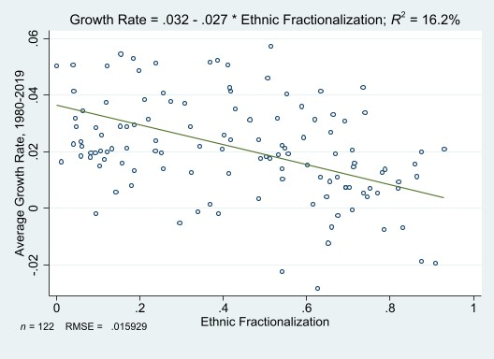
Ethnic Fractionalization
29
29
International Macro History Online Seminar Lecture, February 2024
Notes:
Global Capitalism Master Class
29
29

Slide 30
The short and long of it is that on the simplest level the data show that diversity explains relatively little of growth in the past 40 years, but insofar that there is any correlation it is negative, more pronounced for ethnic fractionalization than for religious/linguistic.
30
30
International Macro History Online Seminar Lecture, February 2024
Notes:
Global Capitalism Master Class
30
30

Slide 31
The other “macro” criterion is the likelihood of violence (Civil War) between different groups, where diversity is measured by the famous ELF index (Ethnic-linguistic fractionalization). Does it correlate with the likelihood of violent conflict?
The classic work of Political Scientists James Fearon and David Laitin suggests it does not. Other definitions of diversity that account for dissimilarities and the coherence of groups (summarized as “polarization”) do, however, correlate with armed conflict (e.g., Montalvo and Reynal-Querol, 2005).
Perhaps the only certain thing to emerge from casual empiricism is that Kranzberg’s Law applies: in countries with “bad” institutions (Ruanda, Ethiopia, Myanmar) diversity leads to violence; in those with “good” institutions (Switzerland, Finland, Canada, Belgium, United States) it leads to high economic performance.
31
31
International Macro History Online Seminar Lecture, February 2024
Notes:
Global Capitalism Master Class
31
31

Slide 32
Finally, turning to economic history:
32
32
International Macro History Online Seminar Lecture, February 2024
Notes:
Global Capitalism Master Class
32
32

Slide 33
One instructive historical example: small ethnic/religious minorities
The relationships between ethnic/religious majorities (in-groups) and minorities (out-groups).
In many historical examples we have cases of such minorities living in societies in which there was a dominant majority:
Jews (everywhere except in Israel)
Roma (in many places in Europe)
German settlers in Russia and the Balkans
Muslims (in India, Myanmar, Israel, now many European countries)
Armenian immigrants, primarily in MENA
Chinese in SE Asia
33
33
International Macro History Online Seminar Lecture, February 2024
Notes:
Global Capitalism Master Class
33
33

Slide 34
“Service Minorities”
In almost all instances there was some inevitable level of prejudice and discrimination, but often a modus vivendi emerged. Not clear how stable that equilibrium was, as it appears fragile in many cases.
Many members of those groups were what is known as “service minorities” --- the minority performed services which the majority did not or could not. Examples: trade, financial services, medicine, estate management. There is no doubt that they were beneficial to the economy. Yet often the minorities were persecuted and expelled.
When would the service minority be tolerated by the majority ruling class and the relations between the two groups reasonably symbiotic and peaceful?
34
34
International Macro History Online Seminar Lecture, February 2024
Notes:
Global Capitalism Master Class
34
34

Slide 35
Six conditions (Jha, 2013, 2022)
Symbiosis: If the two groups produce goods or services, or have competences that are basically complementary.
Locked-in specialization: One group should not be able to replicate or seize and then successfully deploy the resources or competences the other one uses more intensively.
Size and inequality: The “non-local” out-group should not be so small and/or so successful that it can accumulate huge wealth, especially wealth that is transparent and transferable. That may give the larger and politically stronger in-group a temptation to seize these assets.
Vulnerability: There should not be a large vulnerability gap in that one group is organized for violence and the other is not.
Redistribution: Assuming the minority is economically very successful, a reasonably harmonious relation demands that income redistribution between two groups can take place without violence while maintaining incentives (e.g., tax the successful minority but not at confiscatory rates).
Intertemporal tradeoff: The discount rate of the ruling class or in-group is not too high.
35
35
International Macro History Online Seminar Lecture, February 2024
Notes:
Global Capitalism Master Class
35
35

Slide 36
Jha’s example is Muslims in Indian port cities before the Raj. His argument is that in those cities, the Hindus and Muslims had complementary skills that were not easily replicable but were mutually beneficial. Hence Hindu-Muslim violence was much lower than in the control group in which the two groups competed.
Similar arguments have been made about Jews, who for centuries possessed skills and resources that the non-Jewish majority needed (Botticini and Eckstein, 2012). This was true basically everywhere but especially in Eastern Europe (e.g., Becker and Pascali, AER 2019). The insight of Slezkine (2004; 2nd ed. 2019) is that antisemitism in Eastern Europe flared up in the second half of the nineteenth century because the skills that Jews had in service occupations could now be more easily reproduced by non-Jews, who then used political power to displace Jews and keep them out.
36
36
International Macro History Online Seminar Lecture, February 2024
Notes:
Global Capitalism Master Class
36
36

Slide 37
Yet none of those conditions guarantees peaceful relations: intolerance can be driven by many factors outside economics, such as scapegoatism after some disaster, racist prejudices, and religious fanaticism.
Sadly, economic rationality is not the only factor in good pluralist institutions…
37
37
International Macro History Online Seminar Lecture, February 2024
Notes:
Global Capitalism Master Class
37
37

Slide 38
One serious threat to inter-group harmony
Political entrepreneurs who try to benefit politically from using homophily and prejudice against vulnerable minorities.
Populist demagogues create fake news and false accusations in order to build political power or make money (Glaeser, 2005). Scapegoating some “out-group” is a favorite tactic of populist demagogues.
Such “hate entrepreneurs” can cause serious damage to a culture of tolerance and pluralist institutions.
38
38
International Macro History Online Seminar Lecture, February 2024
Notes:
Global Capitalism Master Class
38
38

Slide 39
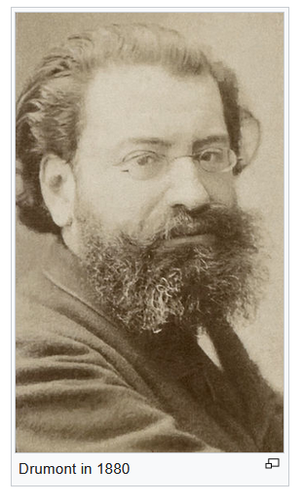
A hate entrepreneur
Édouard Drumont, 1844-1917
39
39
International Macro History Online Seminar Lecture, February 2024
Notes:
Global Capitalism Master Class
39
39

Slide 40
Diversity in European History
The most striking part is religious diversity.
In medieval western Europe, the Latin Church had a virtual monopoly, but clear was anti-pluralist (organized “crusades” and the inquisition, against Muslims and heretics).
40
40
International Macro History Online Seminar Lecture, February 2024
Notes:
Global Capitalism Master Class
40
40

Slide 41
Recent research on the costs of religious diversity
In a recent paper Coşgel, Miceli and Yildirim (2023) take a new look at religious fractionalization in the past and show that it led to more civil strife after 1960 if government did not follow the principles of pluralism but had in the past favored one religion at the expense of another, e.g., N. Ireland.
This is a nice application of Kranzberg’s Law: when institutions are “bad”, diversity leads to conflict.
But can we say more? What we have in Europe is one of the most striking “natural experiments” in diversity in history.
41
41
International Macro History Online Seminar Lecture, February 2024
Notes:
Global Capitalism Master Class
41
41

Slide 42
Historical Example: The Reformation
A good example of how good or bad institutions, driven by cultural beliefs have important economic effects through mediating the impact of diversity can be found in the centuries following the Reformation.
The Protestant Reformation in Europe by definition increased religious diversity in Europe.
What were its economic effects?
42
42
International Macro History Online Seminar Lecture, February 2024
Notes:
Global Capitalism Master Class
42
42

Slide 43
Economic effects of the Reformation
Basically, for the first century and a half, the institutions were “bad”, driven by a culture of intolerance and bigotry, so that the net effects of diversity on economic growth were largely negative.
Examples are obvious: the holy inquisition and its bloody and destructive persecutions of “heretics,” “apostates” and “infidels”; exclusion of religious minorities from various sectors; sharpening of censorship and oppression of dissidents, especially of counter-reformation (Cabello, 2023).
In many areas, religious intolerance led to wars that had devastating economic effects.
43
43
International Macro History Online Seminar Lecture, February 2024
Notes:
Global Capitalism Master Class
43
43

Slide 44
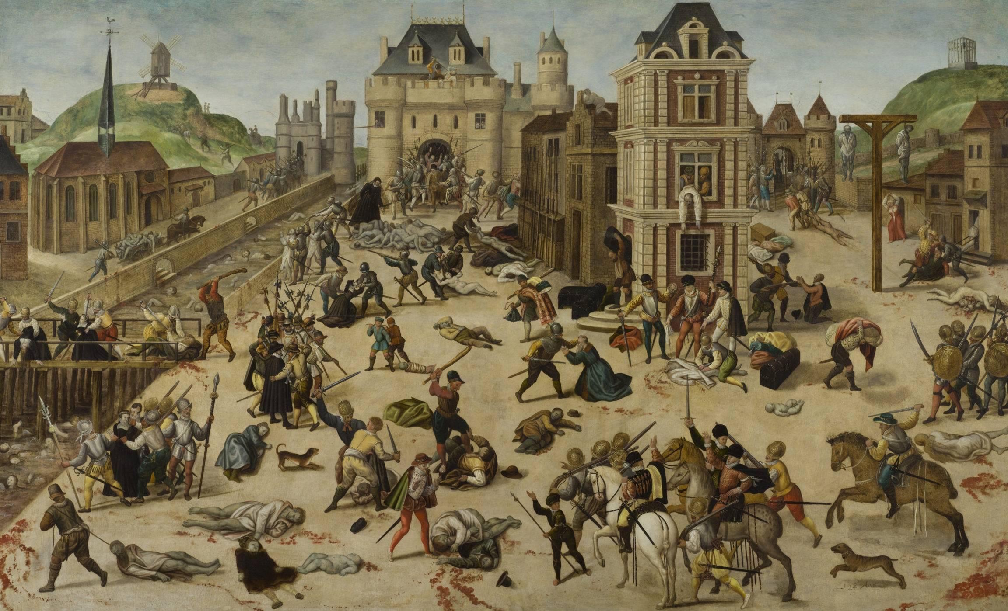
St Bartholomew’s Day Massacre, 1572
Spanish Fury, 1576
44
44
International Macro History Online Seminar Lecture, February 2024
Notes:
Global Capitalism Master Class
44
44

Slide 45
Rise of a culture of tolerance
At some point after 1650 these attitudes began to change: the idea of religious tolerance caught on in the seventeenth century among the more educated classes and slowly started to map into more pluralist institutions.
This happened gradually and unevenly with many setbacks. Pluralism at this time meant at best peaceful co-existence and “freedom of conscience” --- it did not mean immediate full emancipation.
45
45
International Macro History Online Seminar Lecture, February 2024
Notes:
Global Capitalism Master Class
45
45

Slide 46
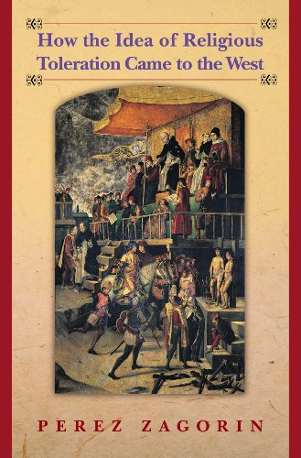
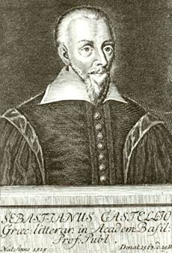
Cultural beliefs about tolerance emerged in the sixteenth century.
Historically, how cultural beliefs about tolerance emerged and then turned into rules, norms and institutions is at the center of the story.
Sebastian Castellio, 1515-1563
46
46
International Macro History Online Seminar Lecture, February 2024
Notes:
Global Capitalism Master Class
46
46

Slide 47
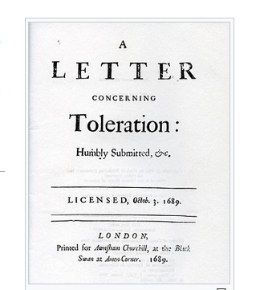
A Philosophy of Tolerance: the Enlightenment
The European Enlightenment was not inherently a secular and atheist movement --- though some of its philosophes were. But it was overwhelmingly culturally tolerant.
The defining book of the early Enlightenment was John Locke’s Letters on Toleration.
47
47
International Macro History Online Seminar Lecture, February 2024
Notes:
Global Capitalism Master Class
47
47

Slide 48
The driver of pluralism:
One reason was that it was increasingly recognized that anti-pluralism was costly: Catholic France had guaranteed toleration to Huguenots in 1598 in the Edict of Nantes.
Pluralism was clearly in part driven by economics and pragmatism: the growing realization that bigotry and anti-pluralism were expensive in terms of economic development. But in many cases, rulers were not maximizing income.
48
48
International Macro History Online Seminar Lecture, February 2024
Notes:
Global Capitalism Master Class
48
48

Slide 49
Tolerance vs. Emancipation
Intolerance did not disappear magically in 1648, not even in the most pluralist countries. A case in point: Louis XIV and his senseless revocation of the Edict of Nantes, 1685. France was much impoverished on that account, losing a considerable part of its “upper tail human capital” and some of its best artisans.
Moreover, being “tolerated” was not the same as emancipation. Even the relatively more pluralist institutions (formal and informal) of western societies before c. 1830 were far from color/race/religion blind.
Greater tolerance for much of 18th Century Europe could still be consistent with serious discrimination against minority groups at many levels.
In Great Britain, after the 1689 Act of Toleration, dissenters could live and practice their religion, but were excluded from many spheres until the Emancipation Act of 1829.
49
Beloit Upton Lecture October 2023
49
Notes:
Global Capitalism Master Class
49
49

Slide 50
After the FR and Napoleon, Europe became more pluralist
By 1815, much of Western Europe adopted more tolerant attitudes and hence more pluralist institutions and benefitted from them in multiple ways.
Oddly enough, Eastern Europe in the nineteenth century moved in the opposite direction. The establishment of the Pale of Settlement in Russia (1791) --- just when France was “emancipating” its Jews.
50
50
International Macro History Online Seminar Lecture, February 2024
Notes:
Global Capitalism Master Class
50
50

Slide 51
The benefits of religious diversity
One way in which constrained religious competition between different religions was beneficial was human capital formation.
Instead of persecuting heretics, the idea was to educate youngsters in the “true faith”. Three examples:
Jesuit Schools
Dissenting Academies
American Colleges in the nineteenth century.
51
51
International Macro History Online Seminar Lecture, February 2024
Notes:
Global Capitalism Master Class
51
51

Slide 52
Some paradigmatic case studies:
The Industrial Revolution in Britain
The Dutch Golden Age
Imperial and Weimar Germany
The Parsis in India
52
52
International Macro History Online Seminar Lecture, February 2024
Notes:
Global Capitalism Master Class
52
52

Slide 53
Great Britain: “Good” Institutions turned diversity into economic success
Late seventeenth-century Britain (Act of Toleration, 1689) became sufficiently pluralist to allow all adherents of dissenting (non-Anglican) religions to live in Britain and practice their religions, even though dissenters and Catholics were excluded from government service and the military.
The influx of highly skilled French Huguenots fleeing Louis XIV’s anti-pluralist France illustrates the consequences: it included some leading Huguenot intellectuals, such as Denis Papin, as well as the crème of the French clock- and watchmaking industry. These had considerable impact on the Industrial Revolution.
53
53
International Macro History Online Seminar Lecture, February 2024
Notes:
Global Capitalism Master Class
53
53

Slide 54
Religious Pluralism in Action
Voltaire, in his sixth letter Regarding the English Nation (1733) pointed out that at the Royal Exchange “the Jew, the Mohammedan and the Christian negotiate with one another as if they were all of the same religion, and the only heretics are those who declare bankruptcy.”
In the Industrial Revolution: Although they were a relatively small fraction (7 percent) of the population, dissenters punched above their weight in the Industrial Revolution. They were not fully emancipated until 1829. This left them with few other career paths than business and entrepreneurship. They supplied a disproportionately large number of leading industrialists in this period, by some estimates around 50 percent.
54
54
International Macro History Online Seminar Lecture, February 2024
Notes:
Global Capitalism Master Class
54
54

Slide 55
Two examples of the value of religious diversity in Britain
Unitarians were a small religious group uniquely well-situated to play a major role in economic progress. Besides Newton himself, in the eighteenth century they included many of the major figures of the Industrial Revolution such as James Watt, Josiah Wedgwood, and the scientist-philosopher Joseph Priestley
Another source of successful businessmen were the Quakers, who numbered no more than 25,000, The Darby’s (pioneers of the iron industry) were the most famous ones.
One micro-study of Birmingham suggests that in the late eighteenth century in that town Quakers made up 1 percent of the town’s population but one-third of its ironmasters and tanners (Jones, 2008, p. 177).
55
55
International Macro History Online Seminar Lecture, February 2024
Notes:
Global Capitalism Master Class
55
55

Slide 56
The Netherlands in the Golden Age
The Netherlands is widely recognized to be the pioneer of European capitalism.
Dutch Capitalism in the golden age was pluralist by instinct. There were many local discriminatory laws on the books, but the de facto informal norms were more tolerant than the formal ordinances. Authorities more often than not turned a blind eye to violations of anti-pluralist laws.
56
Beloit Upton Lecture October 2023, October 2023
56
Notes:
Global Capitalism Master Class
56
56

Slide 57
Colonel Jean Baptiste Stouppe, 1673
“besides those of the reformed (Calvinist) church, we find Roman Catholics, Lutherans, Brownists, Independents, Arminians, Anabaptists, Socinians, Arrians, Enthusiasts, Quakers, Borrelists, Armenians, Muscovites, Libertines” not to mention Jews, Turks, and Persians “in regards that they are not Christians”
57
Beloit Upton Lecture October 2023, October 2023
57
Notes:
Global Capitalism Master Class
57
57

Slide 58
One telling example:
Peter Stuyvesant, the bigoted Dutch governor of New Amsterdam asked for permission from the West India Company to kick out the few Jews that had settled there. The governors wrote back coolly that such as request would be “unreasonable and unfair, especially because of the considerable loss sustained by this nation, with others” (Oppenheim, 1909, p. 8).
Capitalism meant that money talked louder than bigotry and prejudice.
58
Beloit Upton Lecture October 2023, October 2023
58
Notes:
Global Capitalism Master Class
58
58

Slide 59
But something else was at play in the Dutch Republic
The Netherlands in its golden age was a loose confederacy of seven self-governing provinces that ran their own affairs. Decentralization by provinces was compounded by municipal authorities having a large amount of autonomy as well.
Fragmentation of political power and the high degree of autonomy of local government led to competition for the most useful citizens and created an opportunity for minorities to sort themselves into places where they were more welcome.
59
Beloit Upton Lecture October 2023, October 2023
59
Notes:
Global Capitalism Master Class
59
59

Slide 60
There is a deeper lesson here
Decentralized, polycentric government is typically more likely to be pluralist and diverse, simply because of coordination failures.
Powerful autocrats like Ferdinand-Isabella, Louis XIV, or Czar Alexander III could carry out major acts of intolerance (at high cost). In the N’lands this would have been more difficult.
60
Beloit Upton Lecture October 2023, Sept. 2023
60
Notes:
Global Capitalism Master Class
60
60

Slide 61
Germany
Much later, Imperial (1871-1918) and Weimar (1918-1933) Germany were fairly pluralist: there were Protestants, Catholics and Jews, all with equal rights. The formal institutions of imperial Germany rarely discriminated against Catholics (except for a brief episode in the 1870s). Antisemitism was alive and well, of course, but the institutions were reasonably pluralist.
Jews made major contributions to the economy and culture of Imperial and Weimar Germany.
61
61
International Macro History Online Seminar Lecture, February 2024
Notes:
Global Capitalism Master Class
61
61

Slide 62
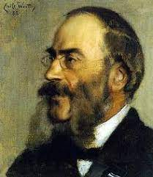
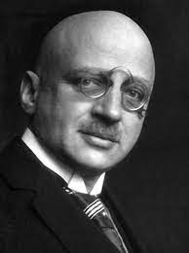
Best-known examples of German Jews in leading positions
Gerson von Bleichröder
Fritz Haber
62
62
International Macro History Online Seminar Lecture, February 2024
Notes:
Global Capitalism Master Class
62
62

Slide 63
But many others
In retailing, finance, the law, medicine, academia, and scientific research, Jews played a major role. Among the major figures:
Albert Ballin, shipping magnate
Emil Rathenau, founder of AEG
Hermann Tietz, founder of a famous department store chain
Abraham Oppenheim, banker
Eugen Gutmann, banker
63
63
International Macro History Online Seminar Lecture, February 2024
Notes:
Global Capitalism Master Class
63
63

Slide 64
Yet there was a cloud on the horizon
These Jewish intellectuals and businessmen violated one of the rules of successful minorities: they competed with rather than complemented successful Germans.
64
64
International Macro History Online Seminar Lecture, February 2024
Notes:
Global Capitalism Master Class
64
64

Slide 65
They were good at activities that non-Jewish Germans were also good at. For every Emil Rathenau there was a Siemens and a Krupp and for every Tietz and Wertheim there were non-Jewish storeowners such as Rudolph Karstadt. In science, Einstein’s success spurred the wrath and jealousy of non-Jewish competitors such as the physicist Philipp Lenard, who famously dubbed Einstein’s work as “Jewish physics.”
This violated one of Jha’s conditions: the “in-group” should not be able to compete easily with the (more successful) out-group.
65
65
International Macro History Online Seminar Lecture, February 2024
Notes:
Global Capitalism Master Class
65
65

Slide 66
The institutions changed abruptly in 1933, the German government adopting an extreme anti-pluralist policy. Jewish assets and positions were greedily snatched away by their jealous non-Jewish competitors and neighbors.
This was not a zero-sum game:
The evidence suggests that German science and medicine paid a heavy price in losing its Jews (Waldinger, 2010, 2012).
66
66
International Macro History Online Seminar Lecture, February 2024
Notes:
Global Capitalism Master Class
66
66

Slide 67
The Parsi population of India.
A good example of the enormous gains that can be secured by being tolerant of a small but different minority. The Parsis are a tiny but cohesive group of Zoroastrians who settled in India after the Muslim conquest of Persia (today Iran). They were allowed to settle in NE India, provided they learned the language and followed local marriage customs.
For centuries they were an unobtrusive farming community in Gujarat, but the arrival of Europeans transformed them, and much like European Jews they learned that education and literacy were the key to economic and social success.
67
67
International Macro History Online Seminar Lecture, February 2024
Notes:
Global Capitalism Master Class
67
67

Slide 68
One of the first Parsis to be a successful entrepreneur
Rustom Maneck (full name: Naoroji Rustomji Manek Seth) 1662-1732. Famously sailed to London, sued for an injustice, won a huge settlement and subsequently built a fabulous ancestral mansion on top of Dongri Hill, situated to the west of Bombay Dock.
68
68
International Macro History Online Seminar Lecture, February 2024
Notes:
Global Capitalism Master Class
68
68

Slide 69
In more recent times the small Parsi community punched way above their weight.
In business, of course, Jamsetji Tata (1839-1904) regarded as the legendary "Father of Indian Industry". He was so influential in the world of industry that Jawaharlal Nehru referred to Tata as a One-Man Planning Commission. Equally prominent was Sir Dinshaw Maneckji Petit, 1st Baronet (1823 – 1901) the pioneer of the modern textile industry in India.
Elsewhere, of course, the great conductor Zubin Mehta and Field Marshall Sam Manekshaw, among many others. Among its most famous members, two intellectuals named Homi Bhabha (not related), one a leading nuclear physicist, the other an influential “critical theorist” at Harvard.
69
69
International Macro History Online Seminar Lecture, February 2024
Notes:
Global Capitalism Master Class
69
69

Slide 70
Final Reflections:
None of this is to suggest that diversity is a necessary condition for economic success. Some of the most successful economies, such as the Scandinavian countries, South Korea, and Japan display little diversity. Other, equally successful ones (Israel, Singapore, Switzerland) are highly diverse.
On the basis of either economic history or contemporary experience, it remains hard to argue that diversity in any dimension is a major (much less an essential) factor in any aspect of economic performance.
70
70
International Macro History Online Seminar Lecture, February 2024
Notes:
Global Capitalism Master Class
70
70

Slide 71
The net sign of its effect on the economy, moreover, depends on the quality of institutions. Under the right circumstances, however, it can provide substantial support for economic development, especially when growth is driven by technological progress.
Perhaps this argues once again for a primary role for institutions --- and importantly pluralism --- in economic development, which seems to be a conclusion that much of the professions seems to gravitate towards.
71
71
International Macro History Online Seminar Lecture, February 2024
Notes:
Global Capitalism Master Class
71
71

Slide 72
72
72
International Macro History Online Seminar Lecture, February 2024
Notes:
Global Capitalism Master Class
72
72

Slide 73
Thank you
73
73
International Macro History Online Seminar Lecture, February 2024
Notes:
Global Capitalism Master Class
73
73

Slide 74
74
74
International Macro History Online Seminar Lecture, February 2024
Notes:
Global Capitalism Master Class
74
74

Slide 75
75
75
International Macro History Online Seminar Lecture, February 2024
Notes:
Global Capitalism Master Class
75
75

