Slide 1
The new US EPA SCC and its relation to the new A-4
David Anthoff
UC Berkeley

Slide 2
Outline
The new US EPA Social Cost of Carbon (SCC)
Discounting and risk valuation in GIVE (and the US SCC)

Slide 3
Timeline 1
Social Cost of Carbon is the harm caused by emitting 1 ton of CO2 in economic terms
US has had an “official” SCC since 2010
In 2017 a National Academies of Sciences panel published a roadmap for a next generation SCC
Two large scale research efforts worked on new SCC estimates
The Climate Impact Lab (DSCIM integrated assessment model)
The Berkeley/RFF Social Cost of Carbon Initiative (GIVE integrated assessment model)

Slide 4
Timeline 2
EPA started working with both initiatives under the Biden administration
Published a draft SCC at the end of 2022
Peer-review, public comment etc.
[A-4 draft published in the summer of 2023]
[A-4 final published at the end of 2023]
Final new SCC at the end of 2023

Slide 5
Did it matter?
Yes!
First generation SCC ~$50/tCO₂
New generation SCC ~ $190/tCO₂

Slide 6
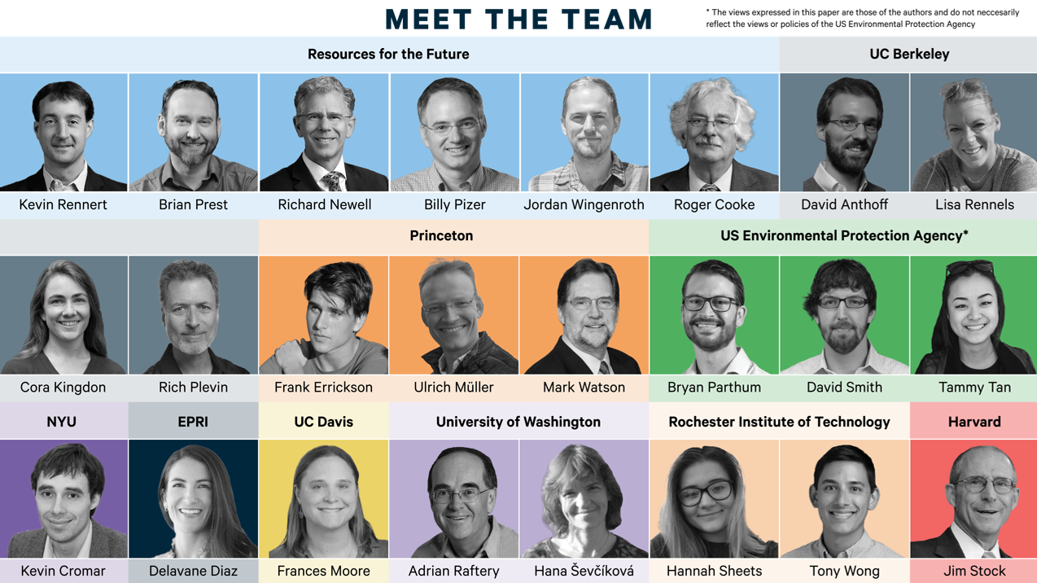
6

Slide 7
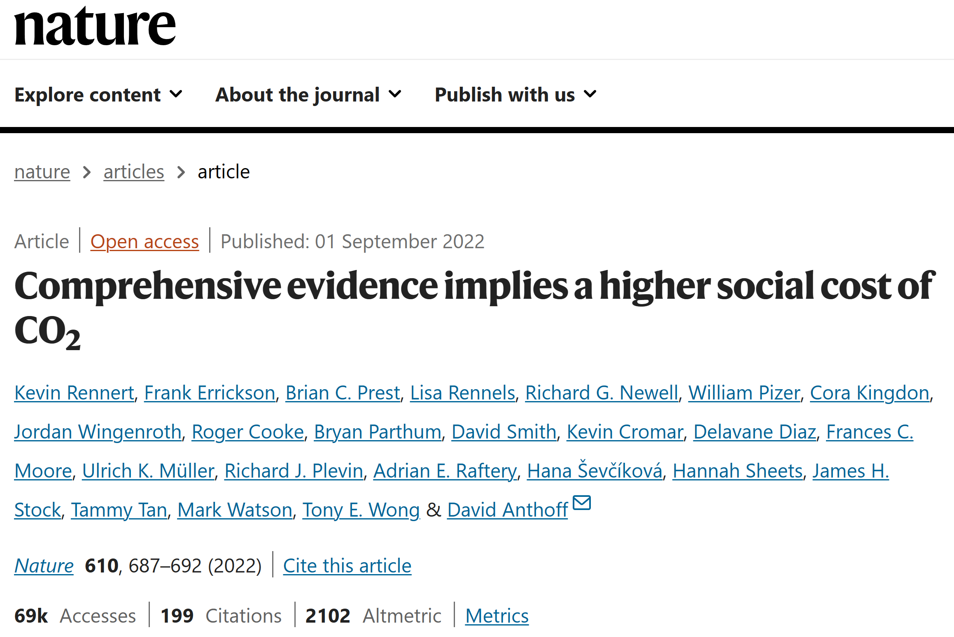

Slide 8
https://www.mimiframework.org/
RFF-SPs
RFF-SPs
RFF-SPs
Scenarios
DSCIM (FAIR & FACTS)
GIVE (FAIR & BRICK)
GIVE (FAIR)
Climate Science
DSCIM (& CIAM)
GIVE (& CIAM)
Howard & Sterner
Meta Analysis
Damages
CCAPM (maybe with twist)
CCAPM
CCAPM
Discounting

Slide 9
Outline
The new US EPA Social Cost of Carbon (SCC)
Discounting and risk valuation in GIVE (and the US SCC)

Slide 10
$$\text{SCC}=𝔼\left[\sum_{t}{{\left(\frac{1}{1+ρ+ηg_{t}}\right)}^{t}MD_{t}}\right]$$
$$p=𝔼\left[mx\right]$$
Stochastic discount factor
Payoff
$$\frac{u^{′}\left(c_{t}\right)}{u^{′}\left(c_{0}\right)}×\frac{1}{{\left(1+ρ\right)}^{t}}$$

Slide 11
$$p=𝔼\left[mx\right]$$
$$𝔼\left[m\right]$$
Risk-free discount factor:

Slide 12
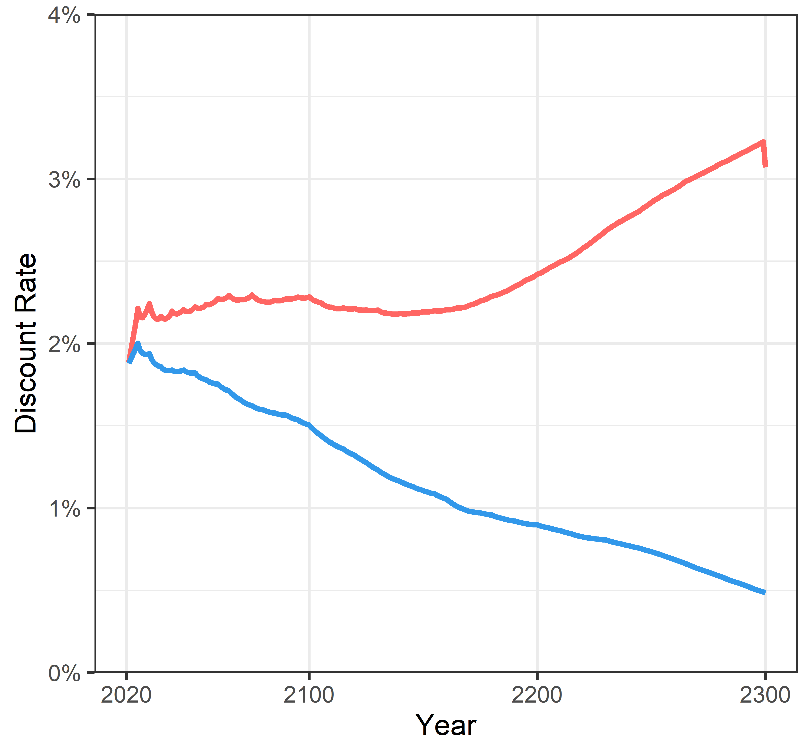
Risk-free discount rate - RFFSP

Slide 13
$$p=𝔼\left[mx\right]$$
$$𝔼\left[m\right]×𝔼\left[x\right]$$
$$\text{iff} cov\left[m,x\right]=0$$
Payoffs should only be discounted at the risk-free rate if they are not correlated with the stochastic discount factor.

Slide 14
$$p=𝔼\left[mx\right]$$
$$m^{ra}×𝔼\left[x\right]=𝔼\left[mx\right]$$
Risk-adjusted discount factor

Slide 15
Discount rates in GIVE
Risk-adjusted
Risk-free

Slide 16
$$p=𝔼\left[mx\right]$$
$$𝔼\left[m\right]×𝔼\left[x\right]+cov\left[m,x\right]=𝔼\left[mx\right]$$
Risk premium

Slide 17
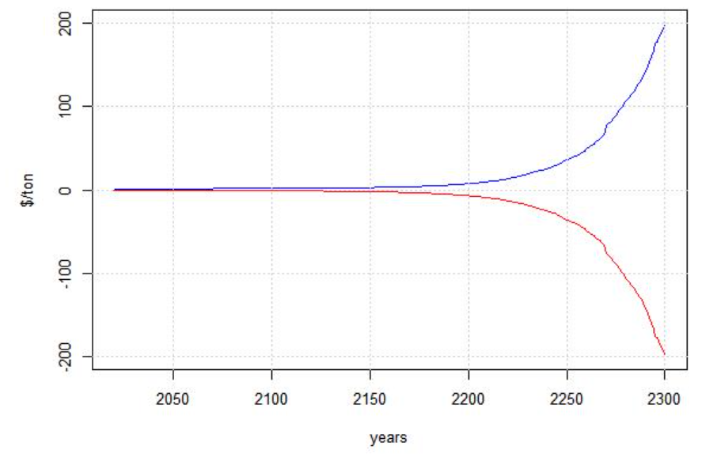
The risk premium is negative

Slide 18
Summary Discounting
We often report the risk-free discount rate from the GIVE model
Our central risk-free rate starts at 2% and then falls over time
BUT: the expected marginal damages in GIVE are not discounted at the risk-free rate
Implicitly, expected marginal damages are discounted at a risk-adjusted rate that increases over time
This is equivalent to a negative risk premium
➔insurance is not the correct analogy when it comes to the risk associated with the SCC

Slide 19
Relation to the new A-4
The new A-4 suggests two ways to deal with risk valuation:
Compute certainty equivalents (preferred)
Use risk-adjusted discount rates
Technically we do neither ☺
We use a stochastic discount factor
But because these are all equivalent ways to do the same thing, we are in practice fully aligned with the new A-4

Slide 20
Thank you!
anthoff@berkeley.edu

